Slide 1
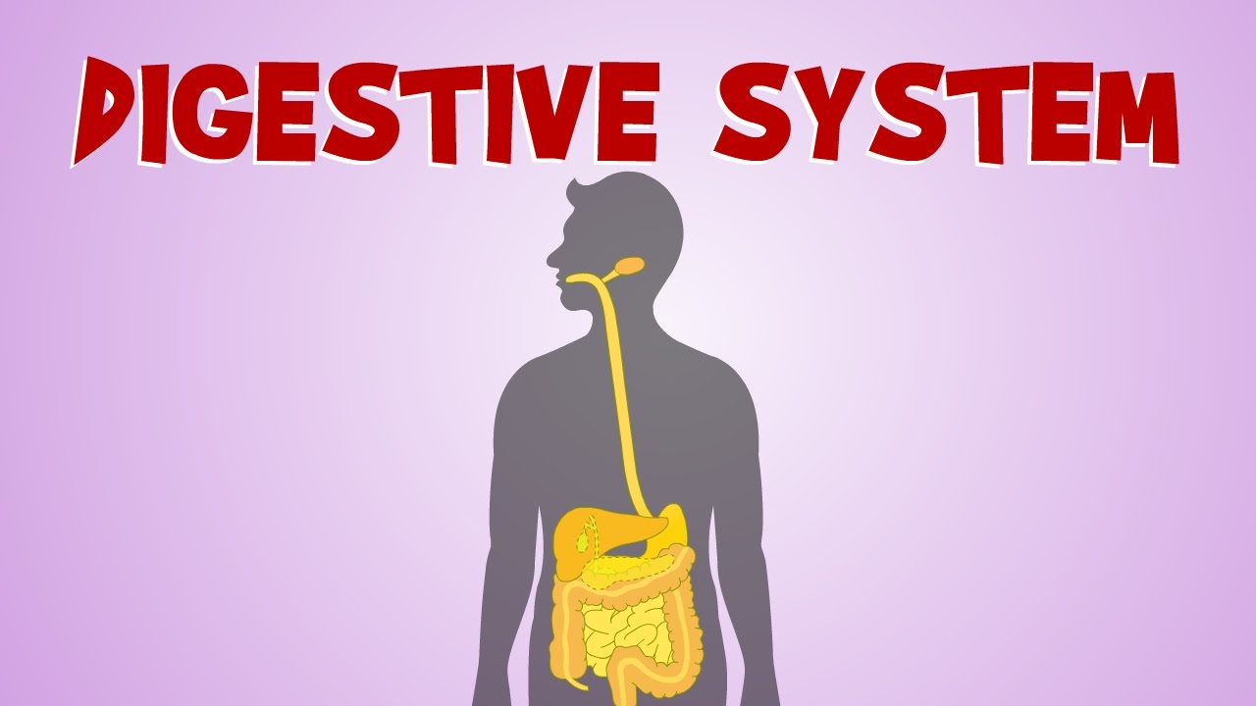
systems
Connected parts that work together
The digestive and excretory systems both help get rid of bodily waste.

Slide 2
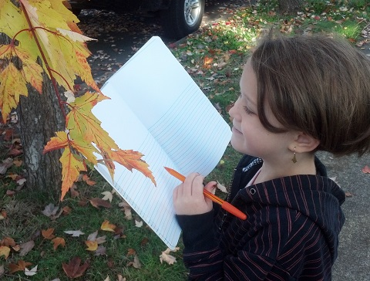
observations
Information gathered by watching closely
Carly watched the birdfeeder, writing down her observations of the birds that came to feed.

Slide 3
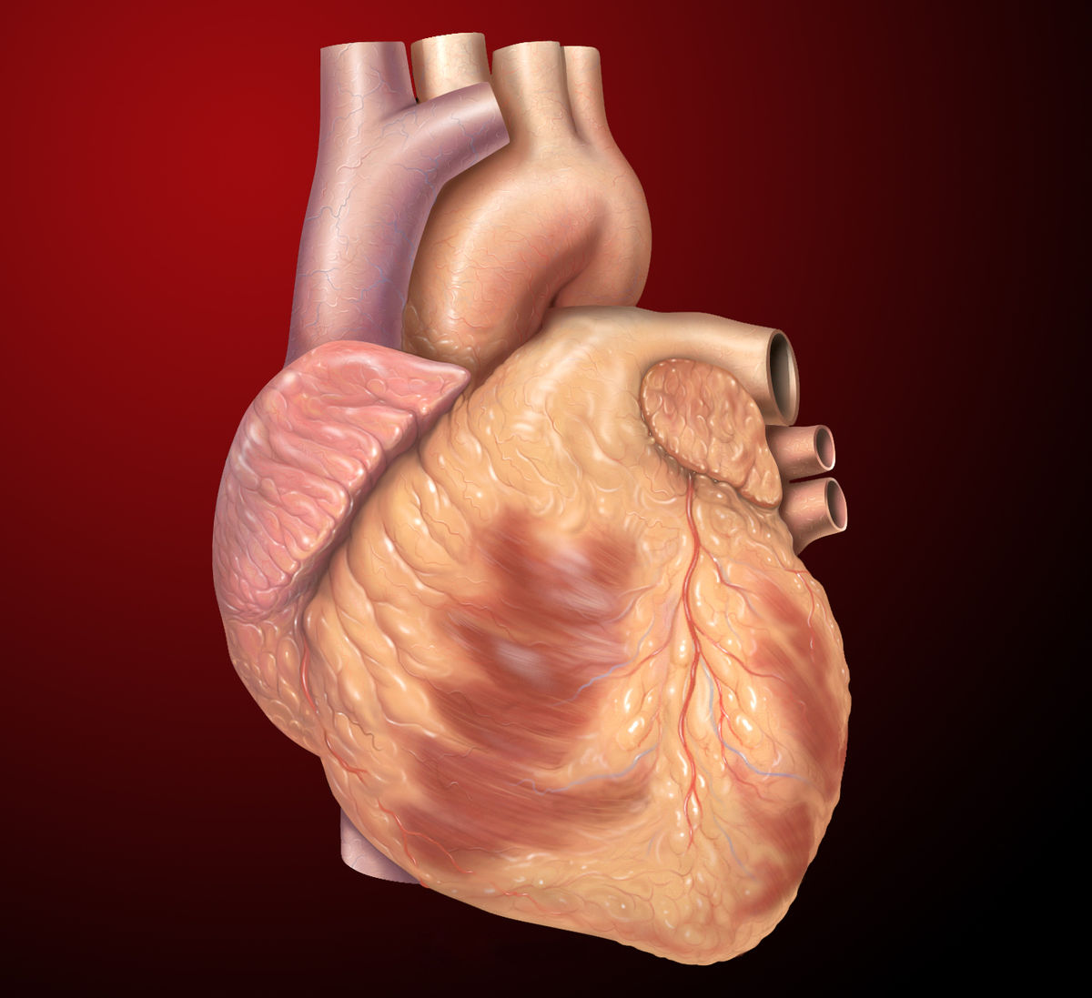
functions
Jobs that support
One of your heart’s functions is to pump blood into other parts of your body.

Slide 4
nourish
To give food or other substance to help grow
Mothers nourish their babies with milk for the first few months of life.

Slide 5
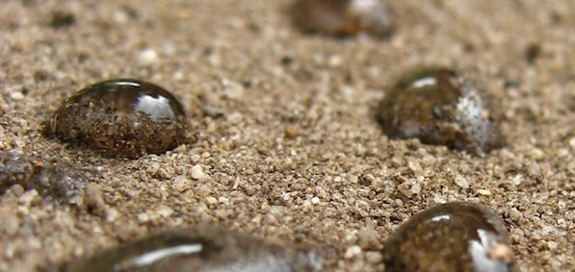
absorb
To take in or soak up
The ground will absorb most of the water when it rains.

Slide 6
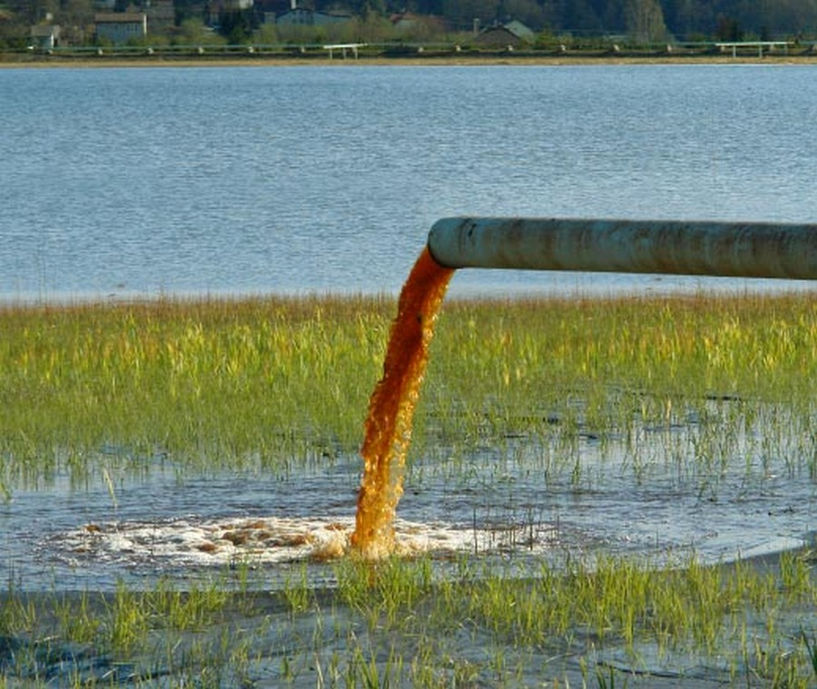
toxic
Poisonous
The chemical factory dumped toxic waste into the river.

Slide 7
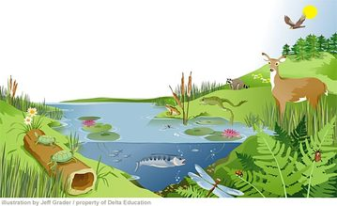
essential
Necessary or Important
Water is essential to the life of all plants and animals on Earth.

Slide 8
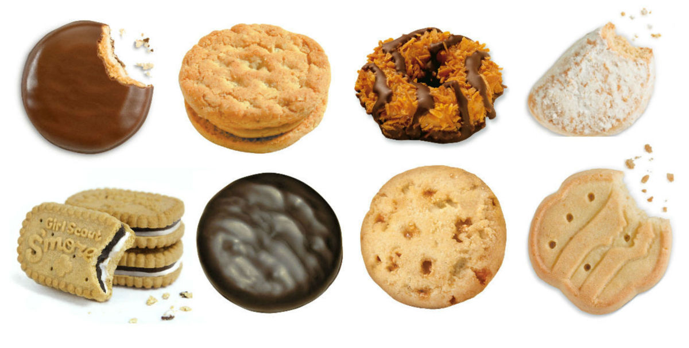
variety
A lot of options
My scout troop sells a wide variety of cookies every year.

Slide 9
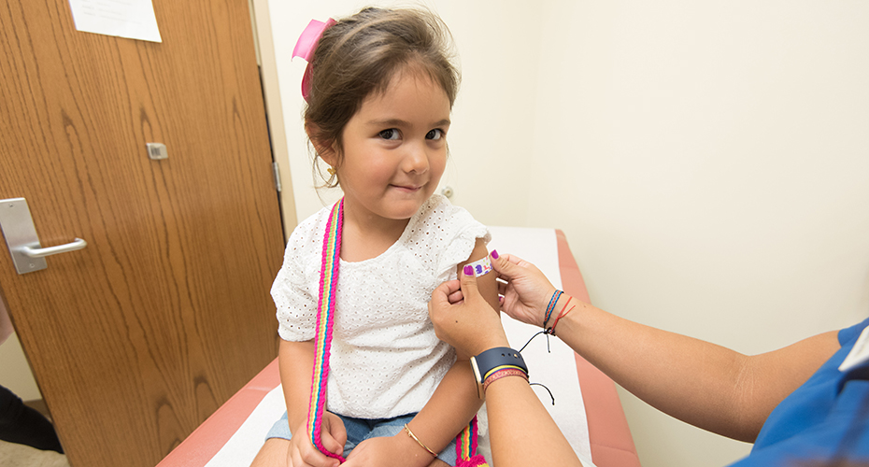
recovery
A return to health
Maria made a fairly quick recovery from the flu.

