Slide 1
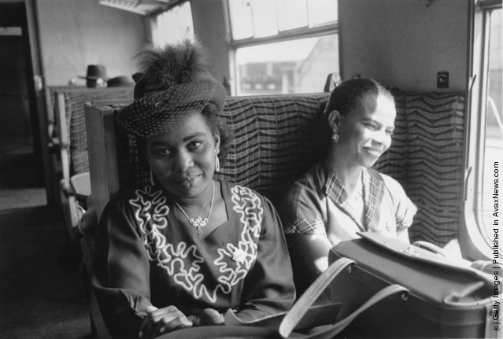
Immigrants
PEOPLE WHO LEAVE THEIR HOME/COUNTRY TO LIVE IN A NEW PLACE
Sasha’s new neighbor is one of the many immigrants from the West Indies in his neighborhood.

Slide 2
opportunity
A chance; a possibility
Jayden was very grateful for the opportunity to go to science camp over the summer and learn more about his favorite subject.

Slide 3
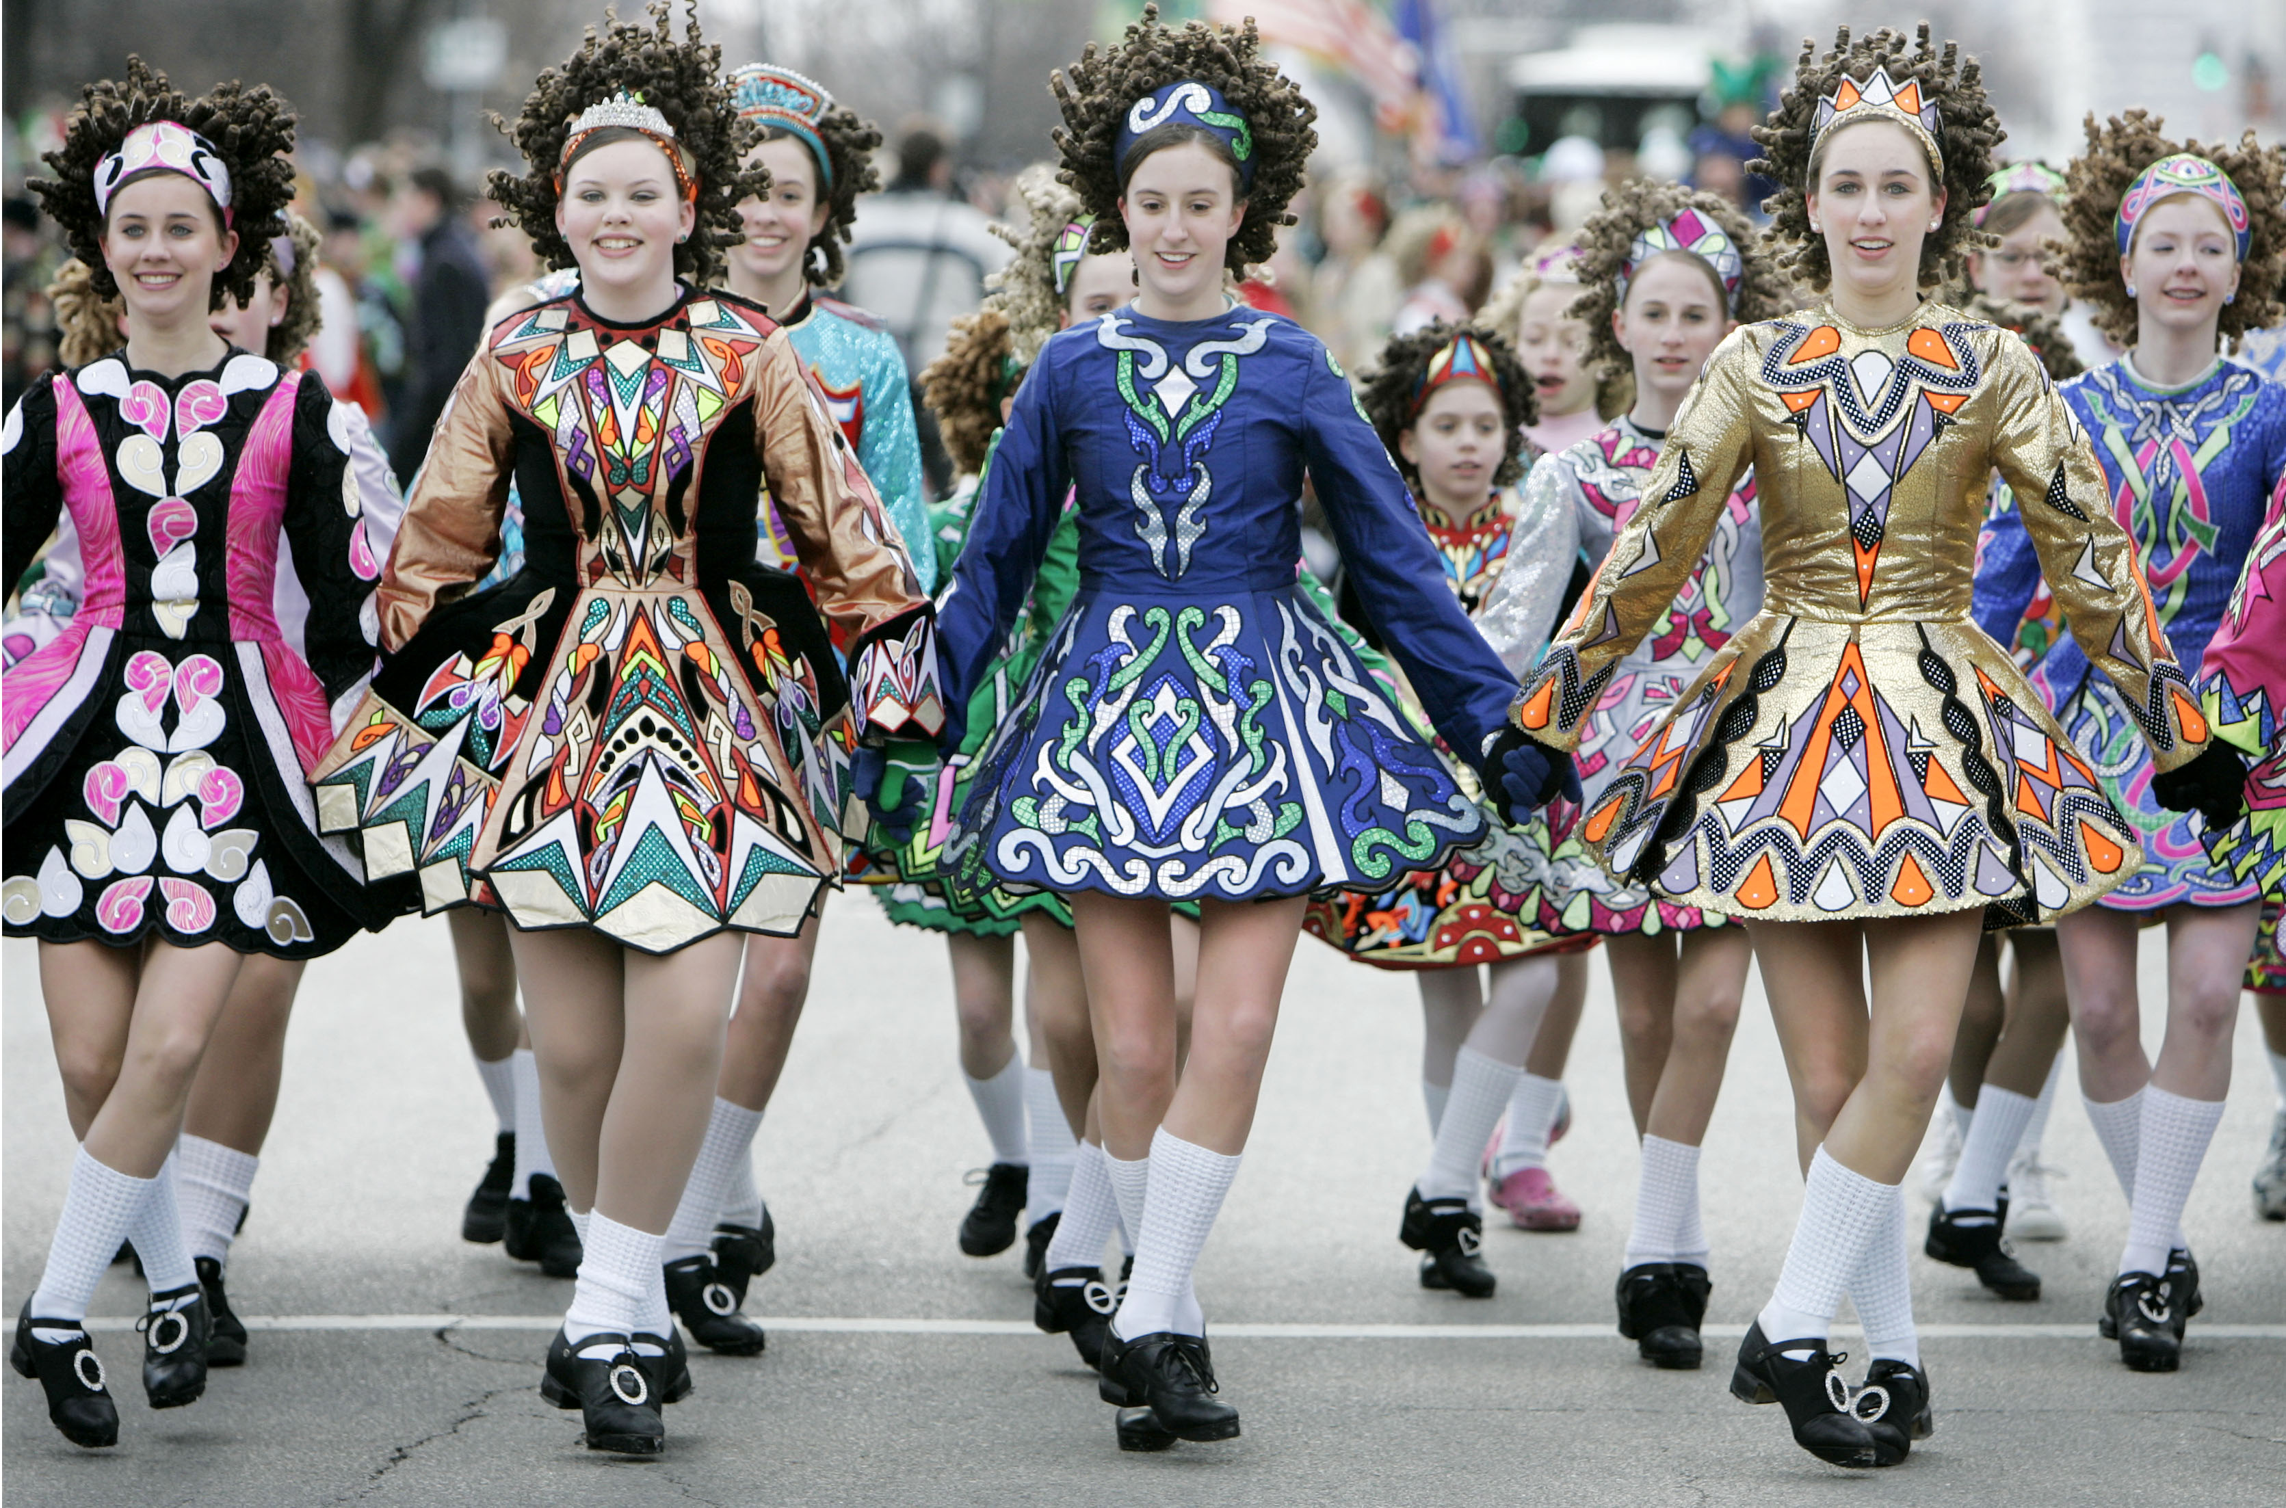
traditional
Something done in the same way for a long time
At the school talent show, Fiona performed a traditional Irish dance that her mother had learned from her grandmother back in Ireland.

Slide 4
afford
To have enough to buy or do something
William could not afford to buy his sister a gift, so he made her a gift instead.

Slide 5
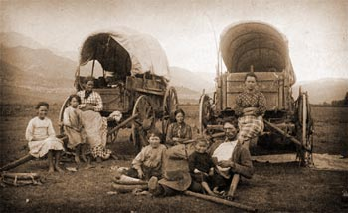
exhausting
Extremely tiring
Traveling the Oregon Trail was a very exhausting journey for many people.

Slide 6
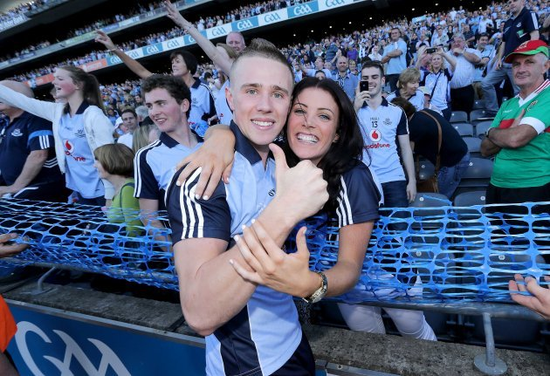
support
To be loyal and encouraging
Tony’s older sister always came to his soccer games to support him.

Slide 7
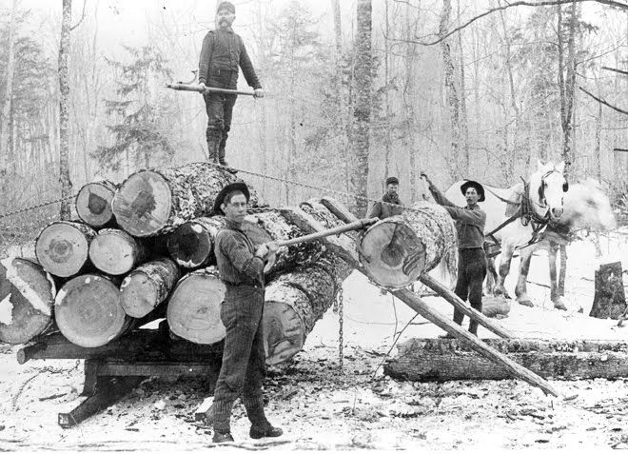
settlers
People who make their new home in a new place.
The immigrant settlers in the Midwest turned the region into some of the finest farmland on earth.

Slide 8
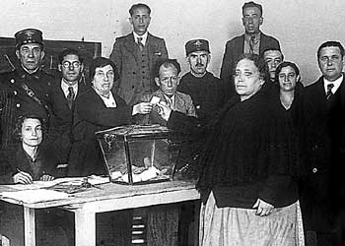
Naturalized citizen
A person born in another country who earns the same rights as native citizens of a different country
Luca’s mother, who was born in Spain, became a naturalized citizen of the United States and was then able to vote in her first presidential election.

Slide 9
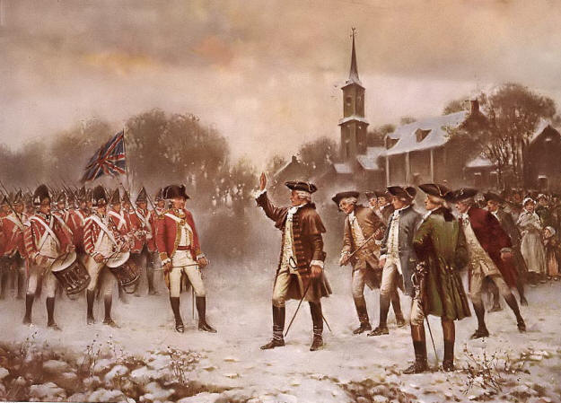
disagreements
Arguments or differences of opinion
Disagreements between the colonists and the king of England eventually led to the Revolutionary War.

Slide 10
guaranteed
Promised that something will be done; made certain
As a U.S. citizen, I am guaranteed certain rights and protections from the U.S. government.

