Slide 1
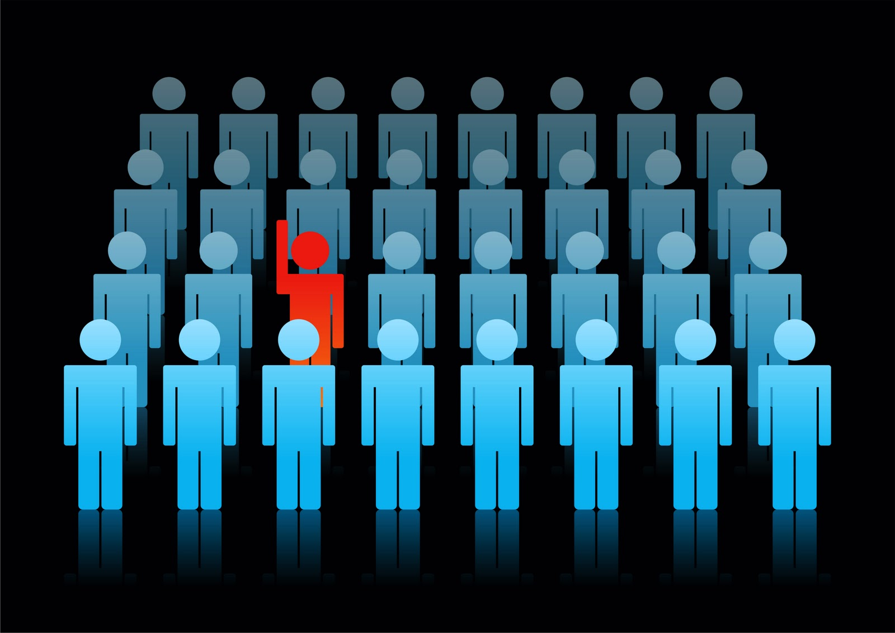
Courage
BRAVERY WHEN FACING DIFFICULTY OR DANGER
It took a great deal of courage to stand up against laws that were unfair.

Slide 2
Ballots
SLIPS OF PAPER USED TO CAST OR RECORD VOTES
Our class used paper ballots to record our votes for our class president.

Slide 3
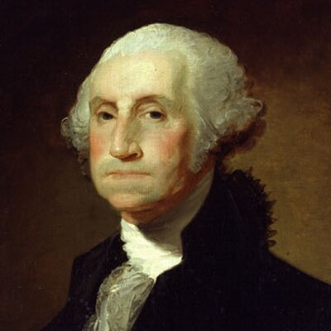
admirable
THE QUALITY OF DESERVING RESPECT OR ADMIRATION
George Washington had many admirable qualities.

Slide 4
proud
FEELING GREAT HONOR OR SATISFACTION
The first-place tennis team was proud of their accomplishments this year.

Slide 5
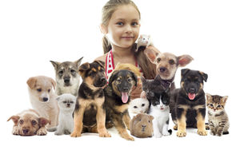
challenge
TO QUESTION WHETHER SOMETHING IS RIGHT OR WRONG
Knowing it was not up for discussion, my sister did not want to challenge my parent’s decision to not get a pet.

Slide 6
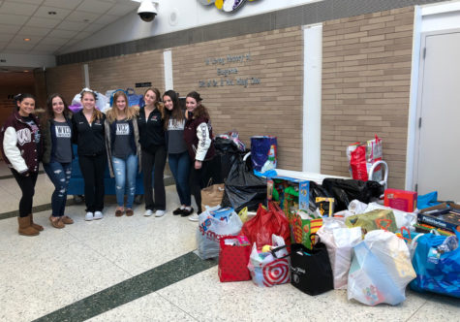
boycott
EXPRESSING STRONG DISAPPROVAL
The community planned to stage a boycott of the store that refused to recycle.

Slide 7
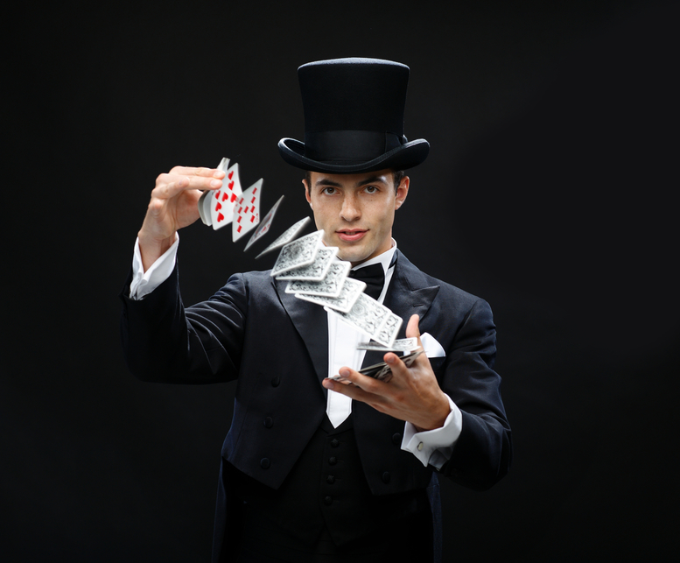
extraordinary
SOMETHING THAT IS INCREDIBLE OR OUT OF THE ORDINARY
The magician’s skills were quite extraordinary and amazed the audience.

Slide 8
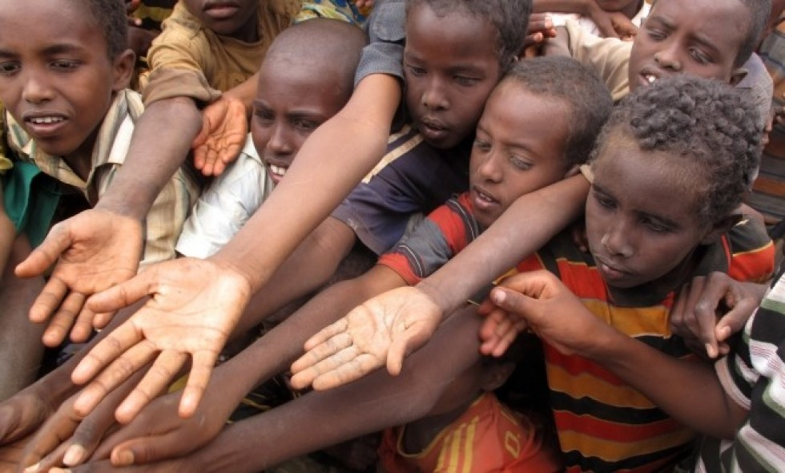
plight
A DIFFICULT OR BAD SITUATION
The plight of the starving people could not be ignored.

Slide 9
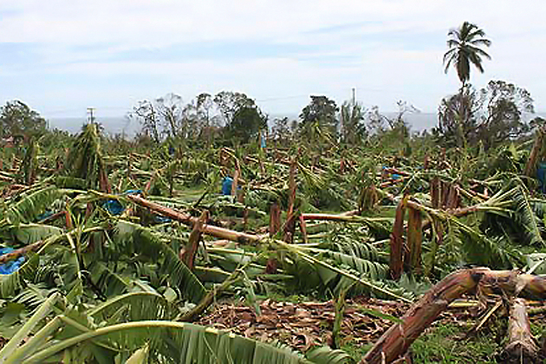
obstacles
PEOPLE OR THINGS THAT STAND IN THE WAY OF FARWARD MOVEMENT OR HOLD UP PROGRESS
There are some obstacles to harvesting crops, such as heavy rains or big storms.

