Slide 1
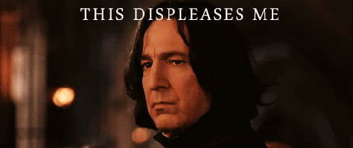
Displeases
bother or upset
Susan displeases her brother by making loud noises when he is studying.

Slide 2
Curious
Want to know more
I am curious to learn more about the stars in the sky.

Slide 3
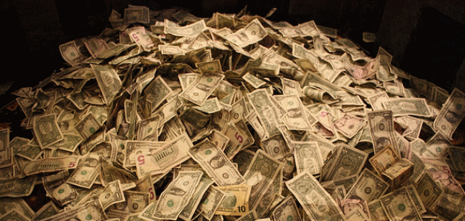
Fortune
A lot of money
The king has a great fortune stored in his castle.

Slide 4
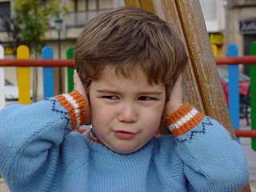
Constant
Happening all the time
The constant noise in the lunchroom was too loud to hear over.

Slide 5
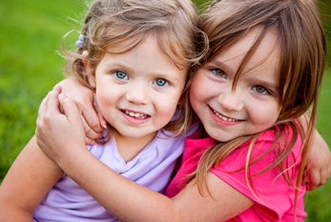
Admiration
To like a lot
Liz had a great deal of admiration for her younger sister, who always tried her best.

Slide 6
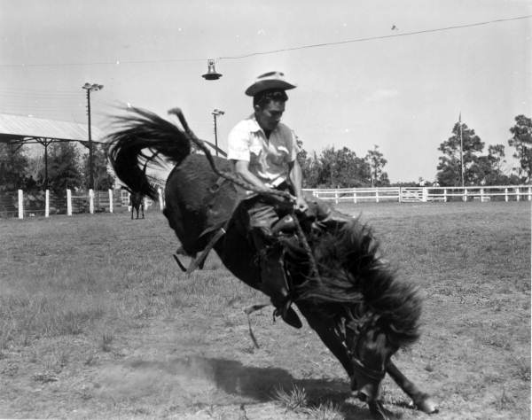
Tame
Train to obey
The cowboy needed to tame his horse.

Slide 7
Feats
Achievements that take courage
The acrobat landed gracefully after the last of her amazing feats.

Slide 8
Legendary
Well-known or Famous
The legendary Pokémon battled the bad guys.

