Slide 1
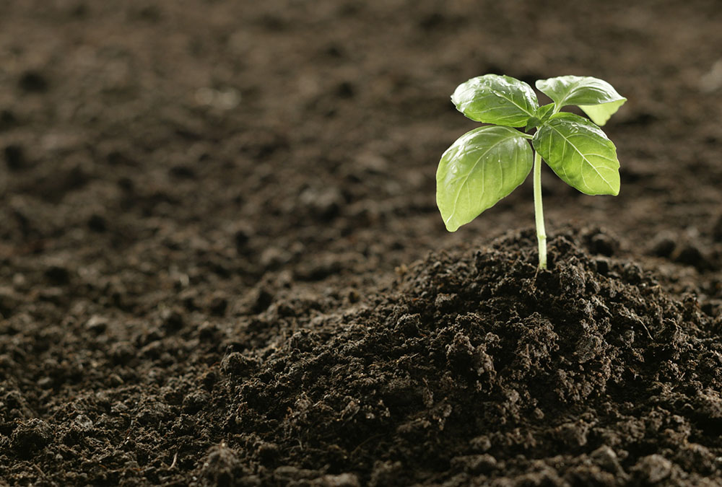
Fertile
HEALTHY
Because Kiara’s farmland was so fertile, she always grew the biggest crops in the county.

Slide 2
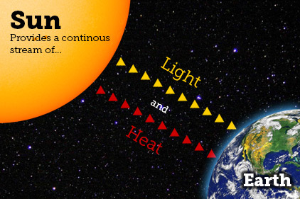
Source
WHERE SOMETHING COMES FROM
The sun is the source of light and heat for planet Earth.

Slide 3
Represents
EXPRESSES OR STANDS FOR
The United States flag represents freedom.

Slide 4
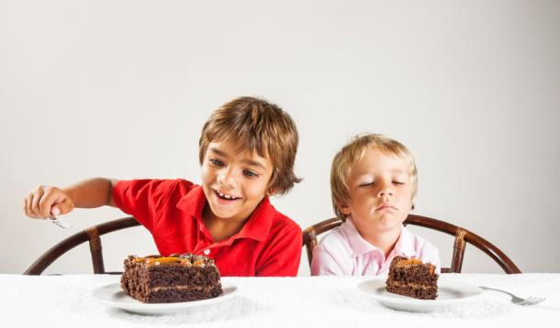
Unjust
NOT RIGHT OR FAIR
Melissa claimed that she was innocent and that her punishment was unjust.

Slide 5
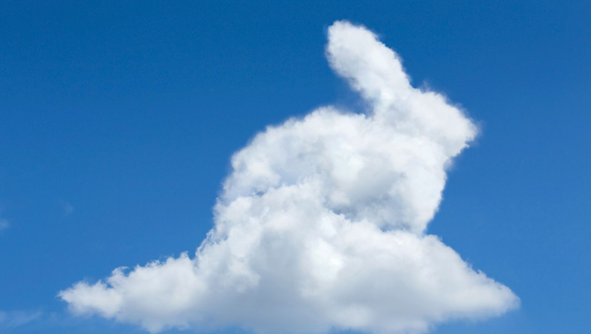
Resembles
LIKENESS TO SOMETHING
Looking up at the sky, Hernando thought to himself, “That cloud resembles a rabbit.”

Slide 6
Custom
TRADITION
It was Taylor’s custom to read a book before he went to sleep each night.

Slide 7
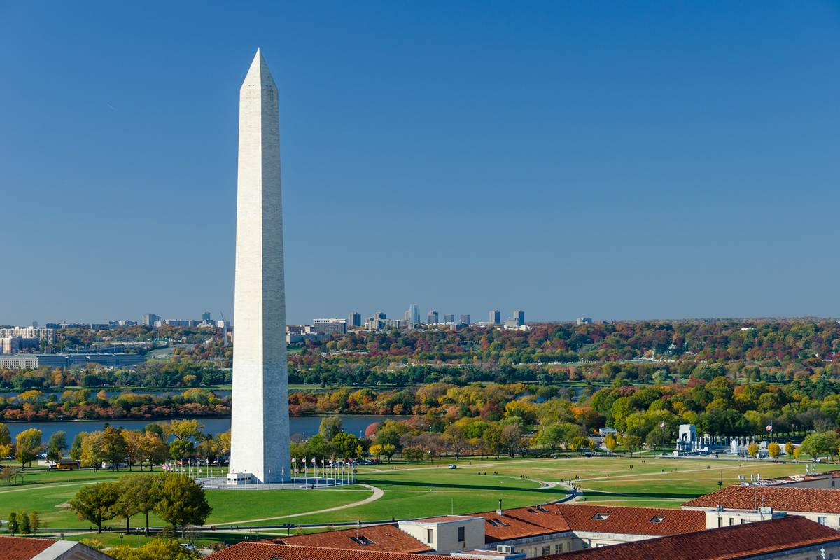
Conquer
TO OVERCOME SOMETHING
To conquer his fear of heights, Alejandro walked to the top of the Washington Monument.

Slide 8
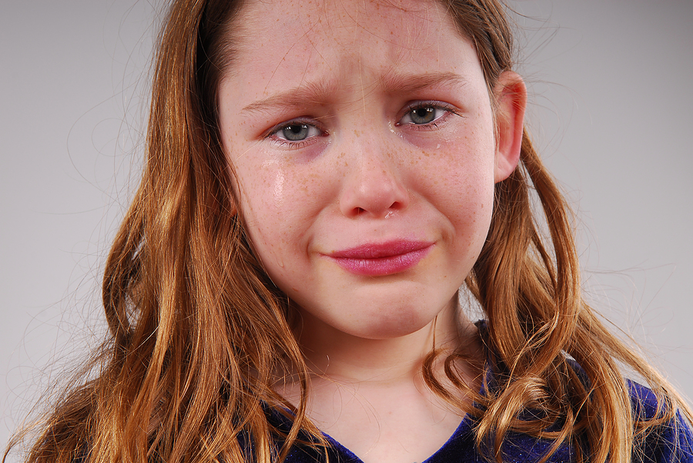
Sorrow
SADDNESS OR PAIN FROM A LOSS
Aya felt great sorrow after losing the ring her mother had given her.

Slide 9
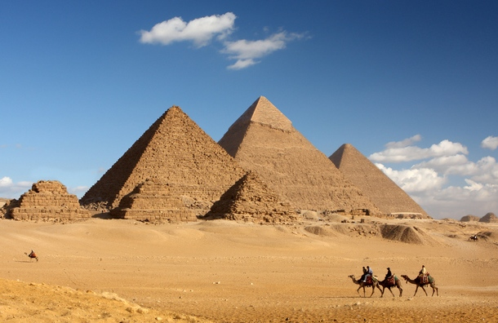
Durable
STRONG AND MADE TO LAST FOR A VERY LONG TIME
The Egyptian pyramids were made with durable materials and have remained intact for thousands of years.

Slide 10
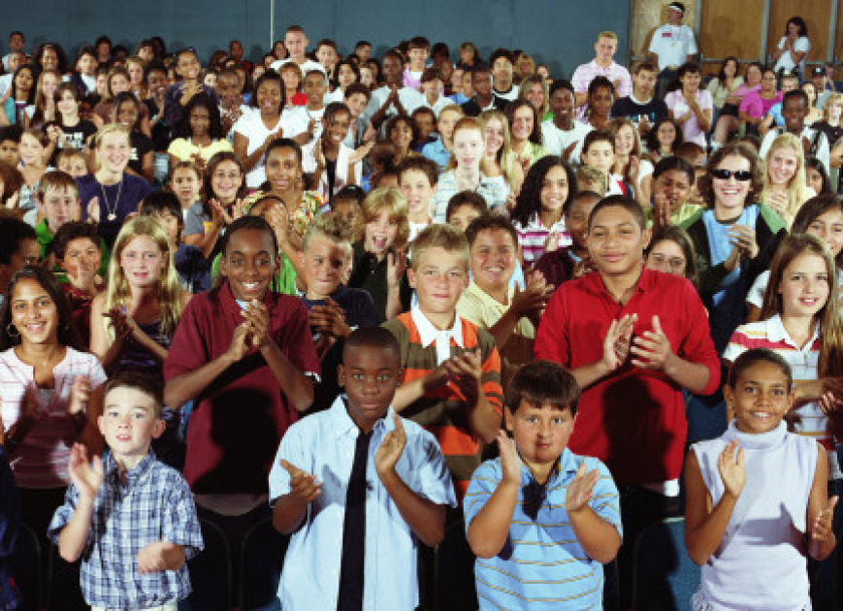
Praise
CONGRATULATIONS
Gilly received much praise for her science project.

Slide 11
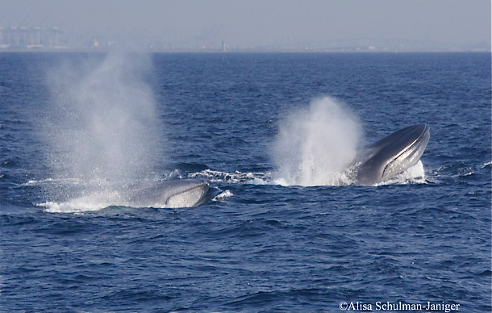
Emerge
TO COME OUT
Whales must emerge from below the water so they can breathe.

Slide 12
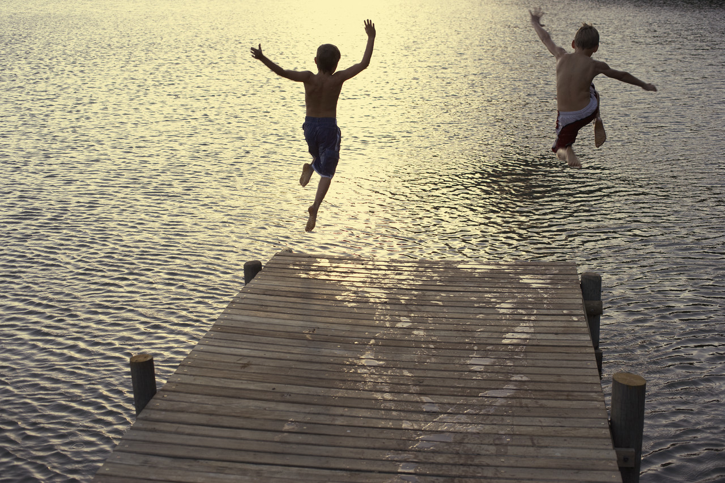
Plunged
QUICK DROP
The hot children jumped off the dock and plunged into the cool water below.

Slide 13
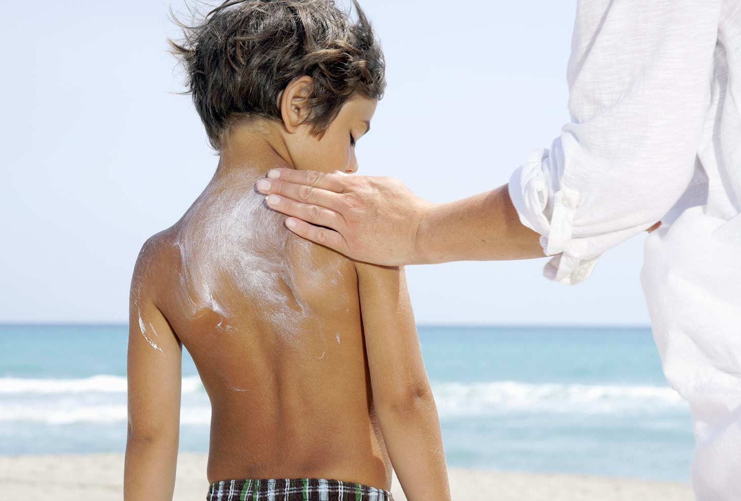
Defense
PROTECTION
Sunscreen is a good defense against the harmful rays of the sun.

Slide 14
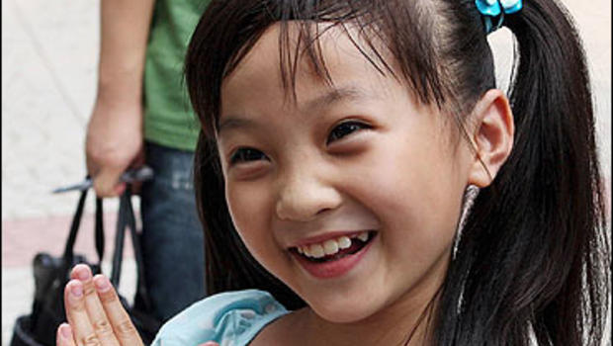
Eager
REALLY WANT TO DO SOMETHING
Lin was eager to hear about the special plans her parents made for her spring break.

Slide 15
Prosperous
SUCCESSFUL
Everyone in the neighborhood wished the new store owners a prosperous start.

