Slide 1
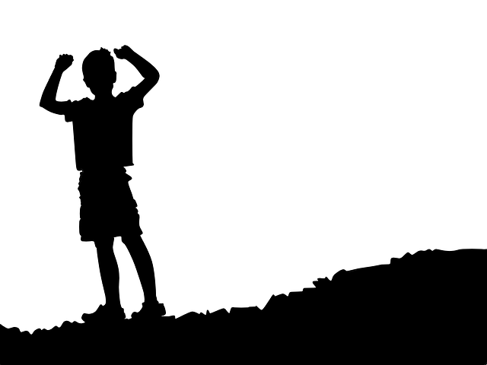
Independently
On your own
As you grow older, you learn to do more things independently, like reading a book by yourself.

Slide 2
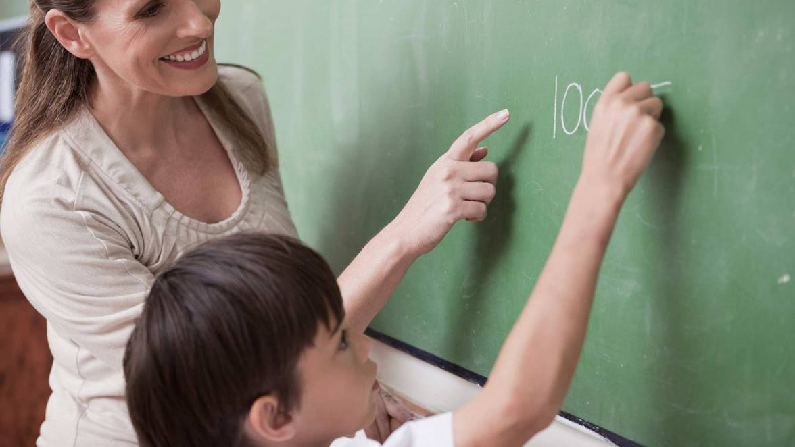
summoned
Asked to come
The teacher summoned a student to the chalkboard to solve a math problem.

Slide 3
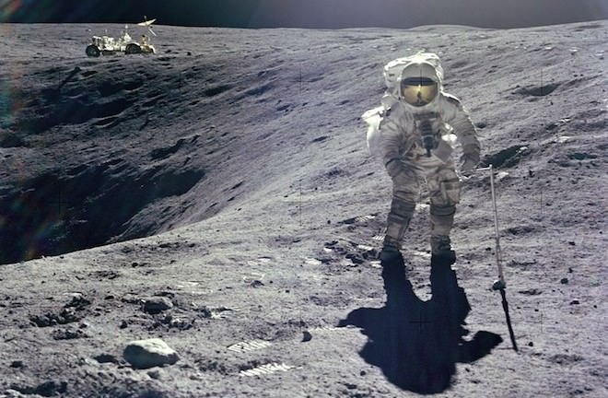
mission
A special job
The astronauts were on a mission to collect rocks from the moon.

Slide 4
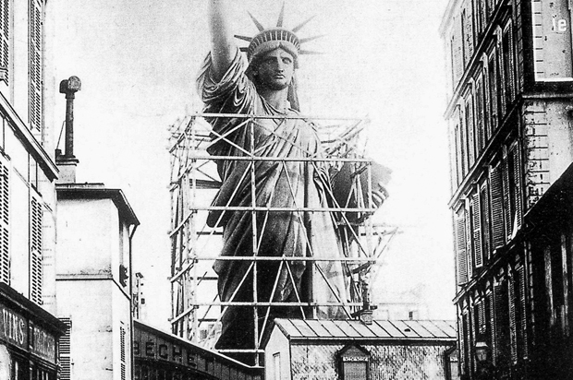
grand
big
Building the Statue of Liberty was a grand accomplishment.

Slide 5
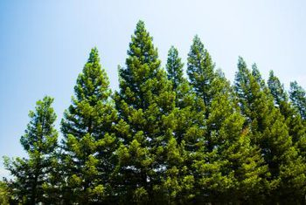
permanently
Long-lasting
I’m glad the pine trees in our yard are permanently green so there’s still some color in the winter.

Slide 6
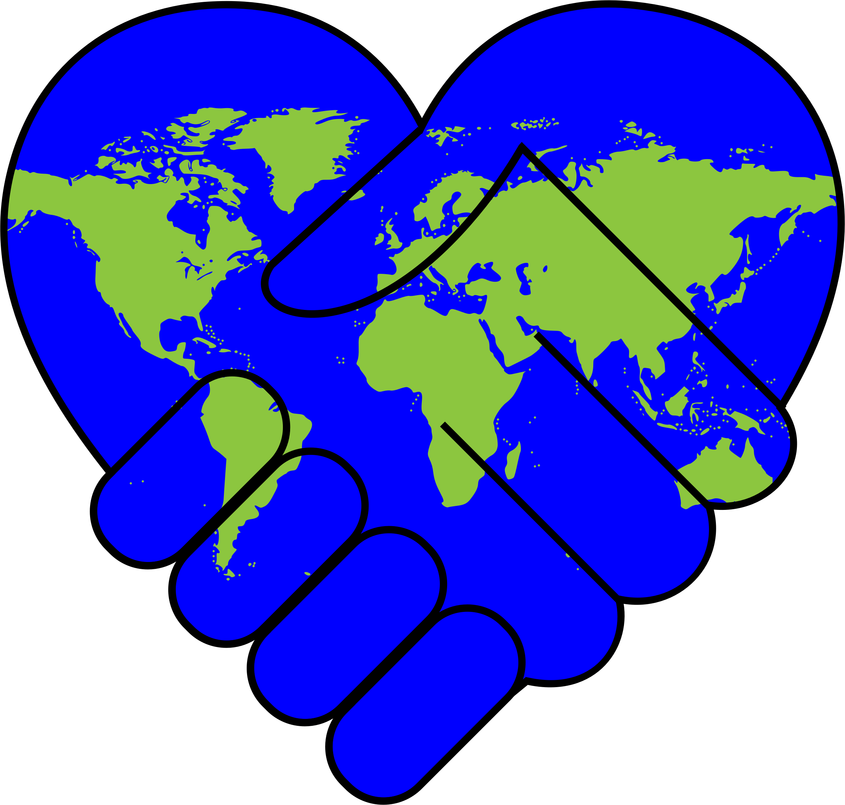
ideal
perfect
In an ideal world, there would be no war.

Slide 7
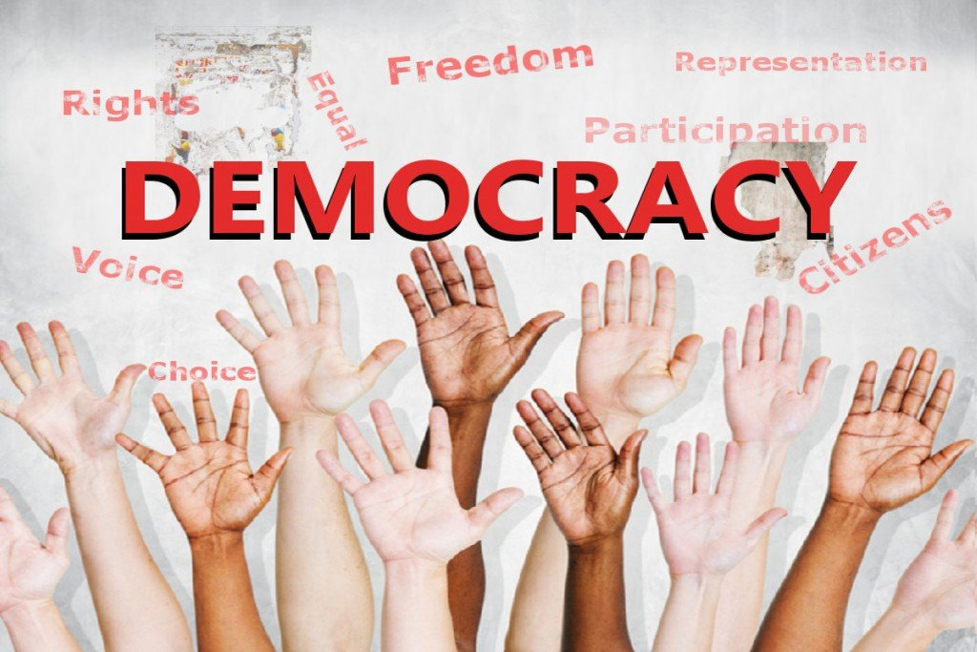
democracy
A way of ruling that gives the people the power to choose their leaders and help create their own laws
Many countries, including the United States, have governments based on the idea of democracy.

Slide 8
tribute
A gift or compliment to honor
My elementary school teacher was given a tribute to honor her many years of service as a teacher.

Slide 9
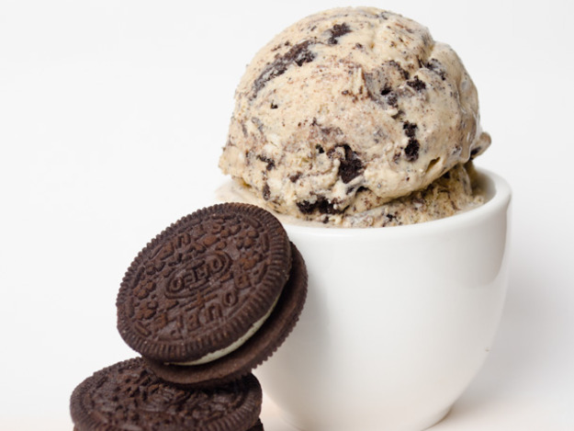
prefer
To choose or like something more than something else
I prefer to eat cookies rather than ice cream.

Slide 10
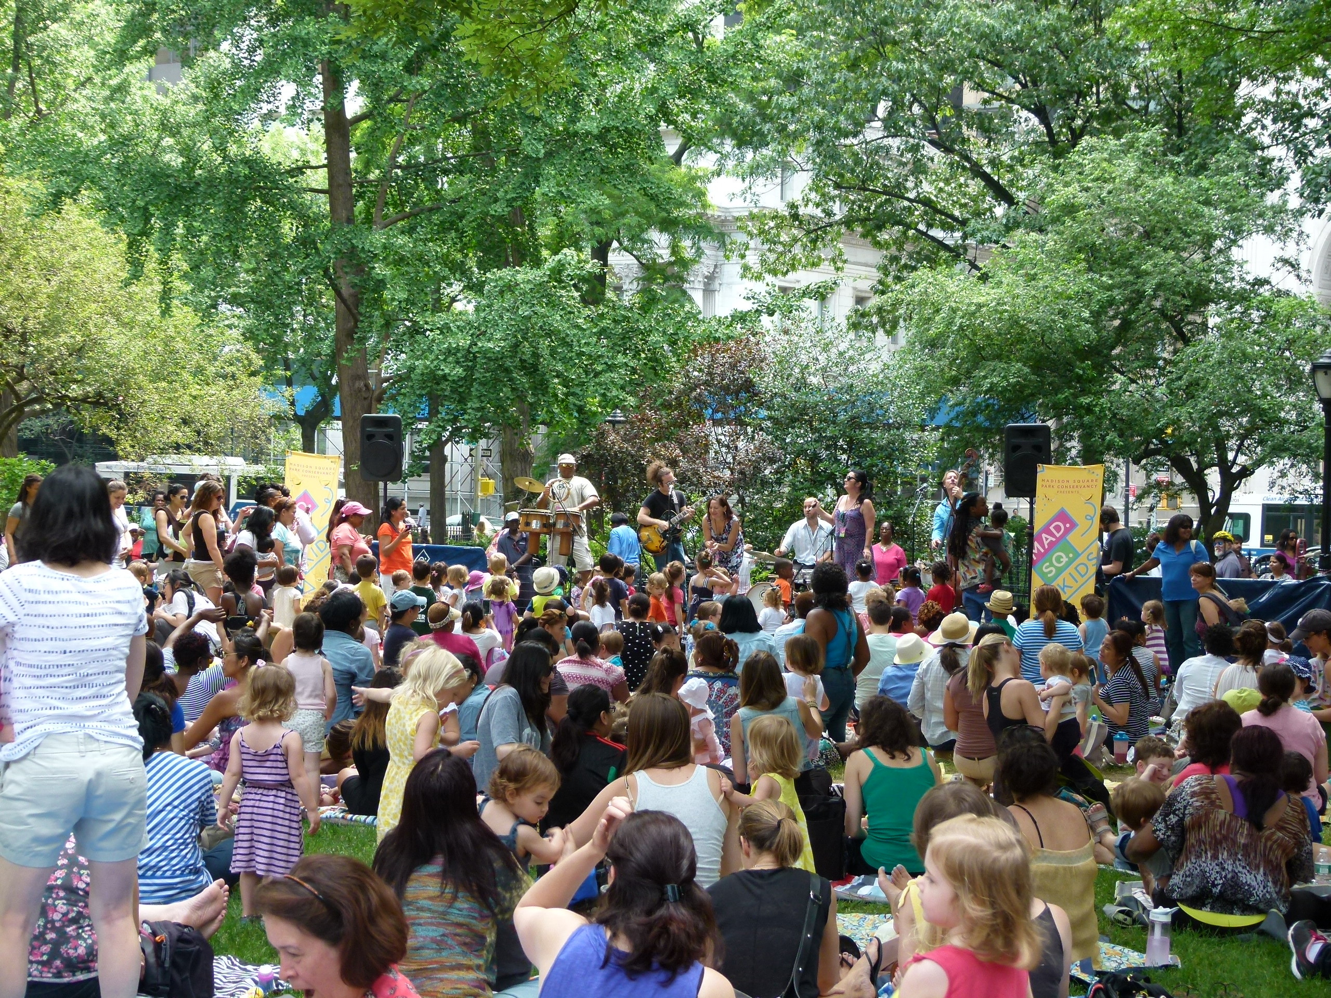
marvelous
Excellent or wonderful
The singing group performed a marvelous concert in the park.

Slide 11
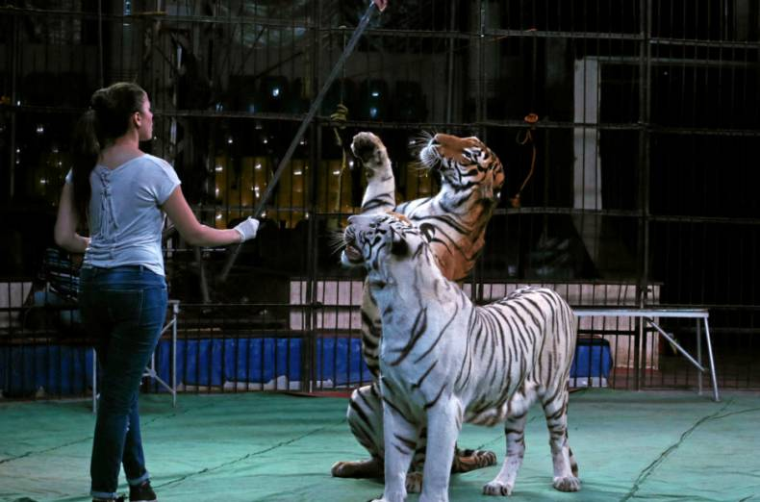
tame
Train to obey
The animal trainer works to tame the tiger for the show.

Slide 12
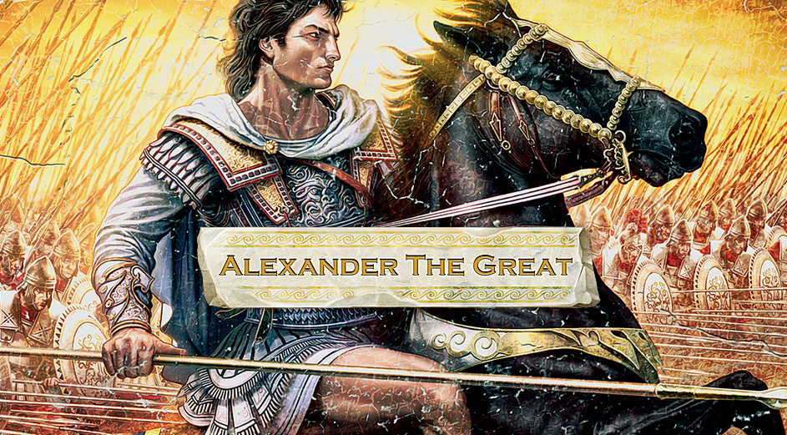
invader
Someone who enters a place in order to conquer it
Alexander the Great is a famous invader of the Persian Empire.

