Slide 1
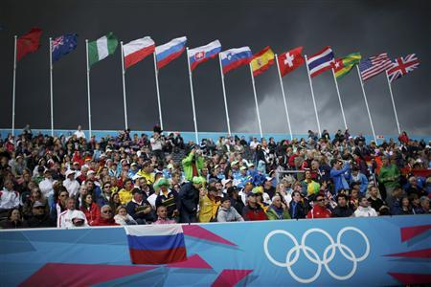
Spectators
People watching an event
Spectators come from distant cities to watch the Olympics.

Slide 2
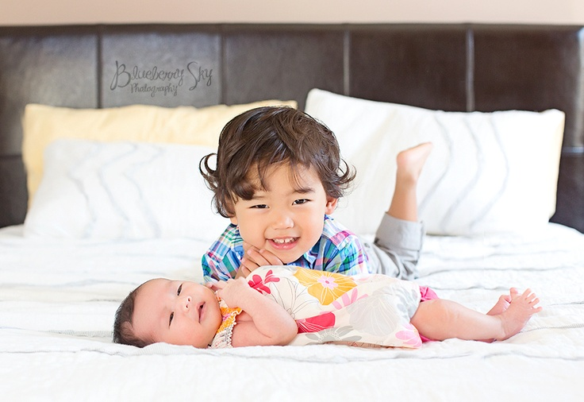
amusing
Happily funny
Chris found his new baby sister amusing to watch; she always made strange sounds and faces as she discovered new things.

Slide 3
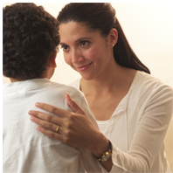
retrieve
Rescue or Bring back
“I’m going across the street to retrieve your brother,” Mike’s mom said.

Slide 4
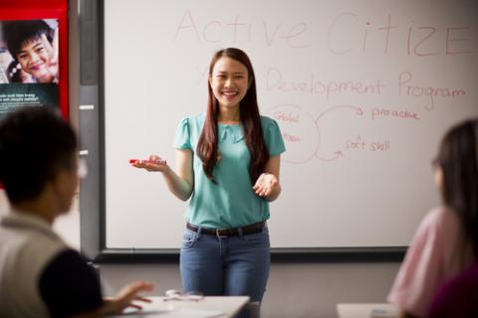
flattered
Happy when given compliments
Jasmine was flattered by the kind compliments her classmates gave her after she presented her book report.

Slide 5
unraveling
Separating
A loose thread from Ming’s scarf got caught on the doorknob, and before she knew it the whole thing was quickly unraveling.

Slide 6
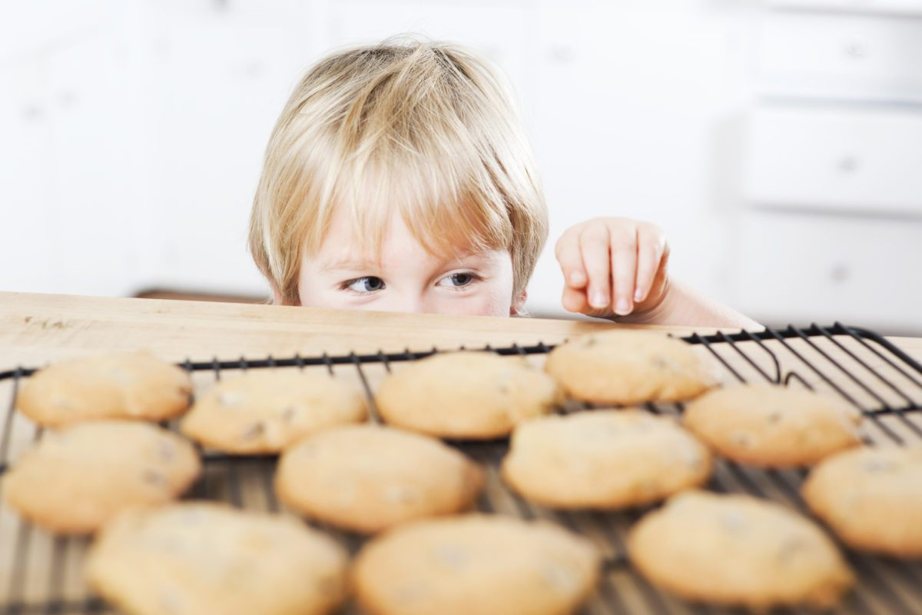
proof
A clue that something is true
Zahra had all the proof she needed when she caught her little brother sneaking cookies before dinner.

Slide 7
aimlessly
Having no plan
The prince wandered aimlessly for several years until Rapunzel found him.

Slide 8
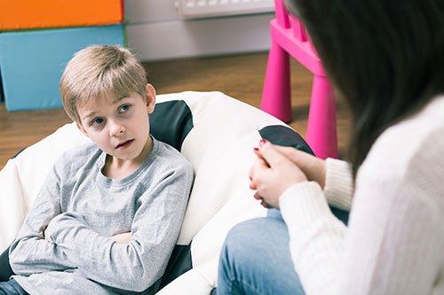
guidance
Giving someone instruction
Toby went to his mom for guidance on what to do when he had a disagreement with his best friend.

Slide 9
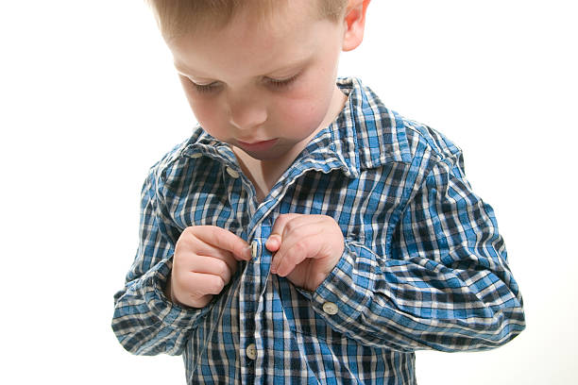
insisted
Ask for something over and over
Charles insisted that he pick out his own clothes every day.

Slide 10
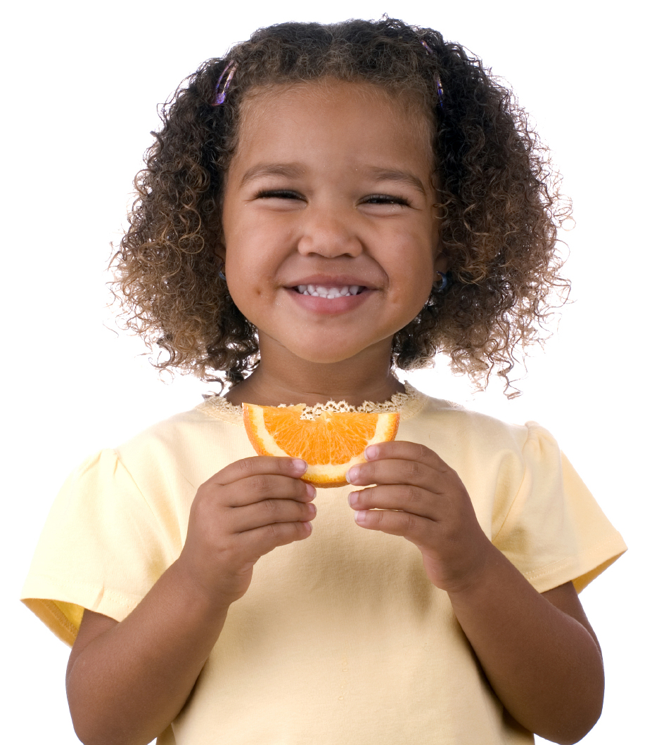
resist
To say no to something
Trixie loved snacks and could never resist a fresh orange.

