Slide 1
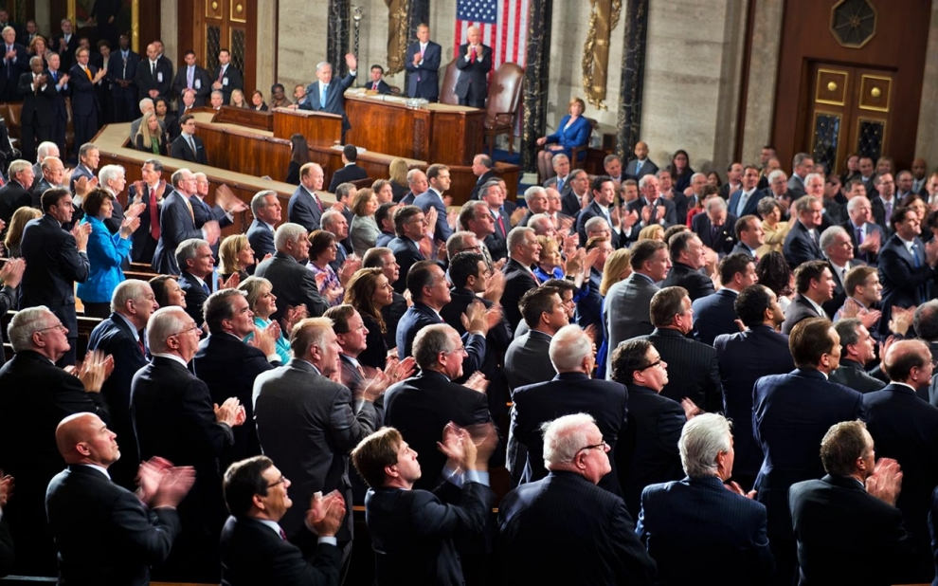
represent
To act or speak for someone
Two senators are elected to represent each of the fifty states.

Slide 2
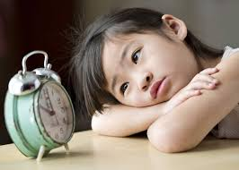
patience
Happily waiting
We had to have a lot of patience when we were waiting all day for the party to start.

Slide 3
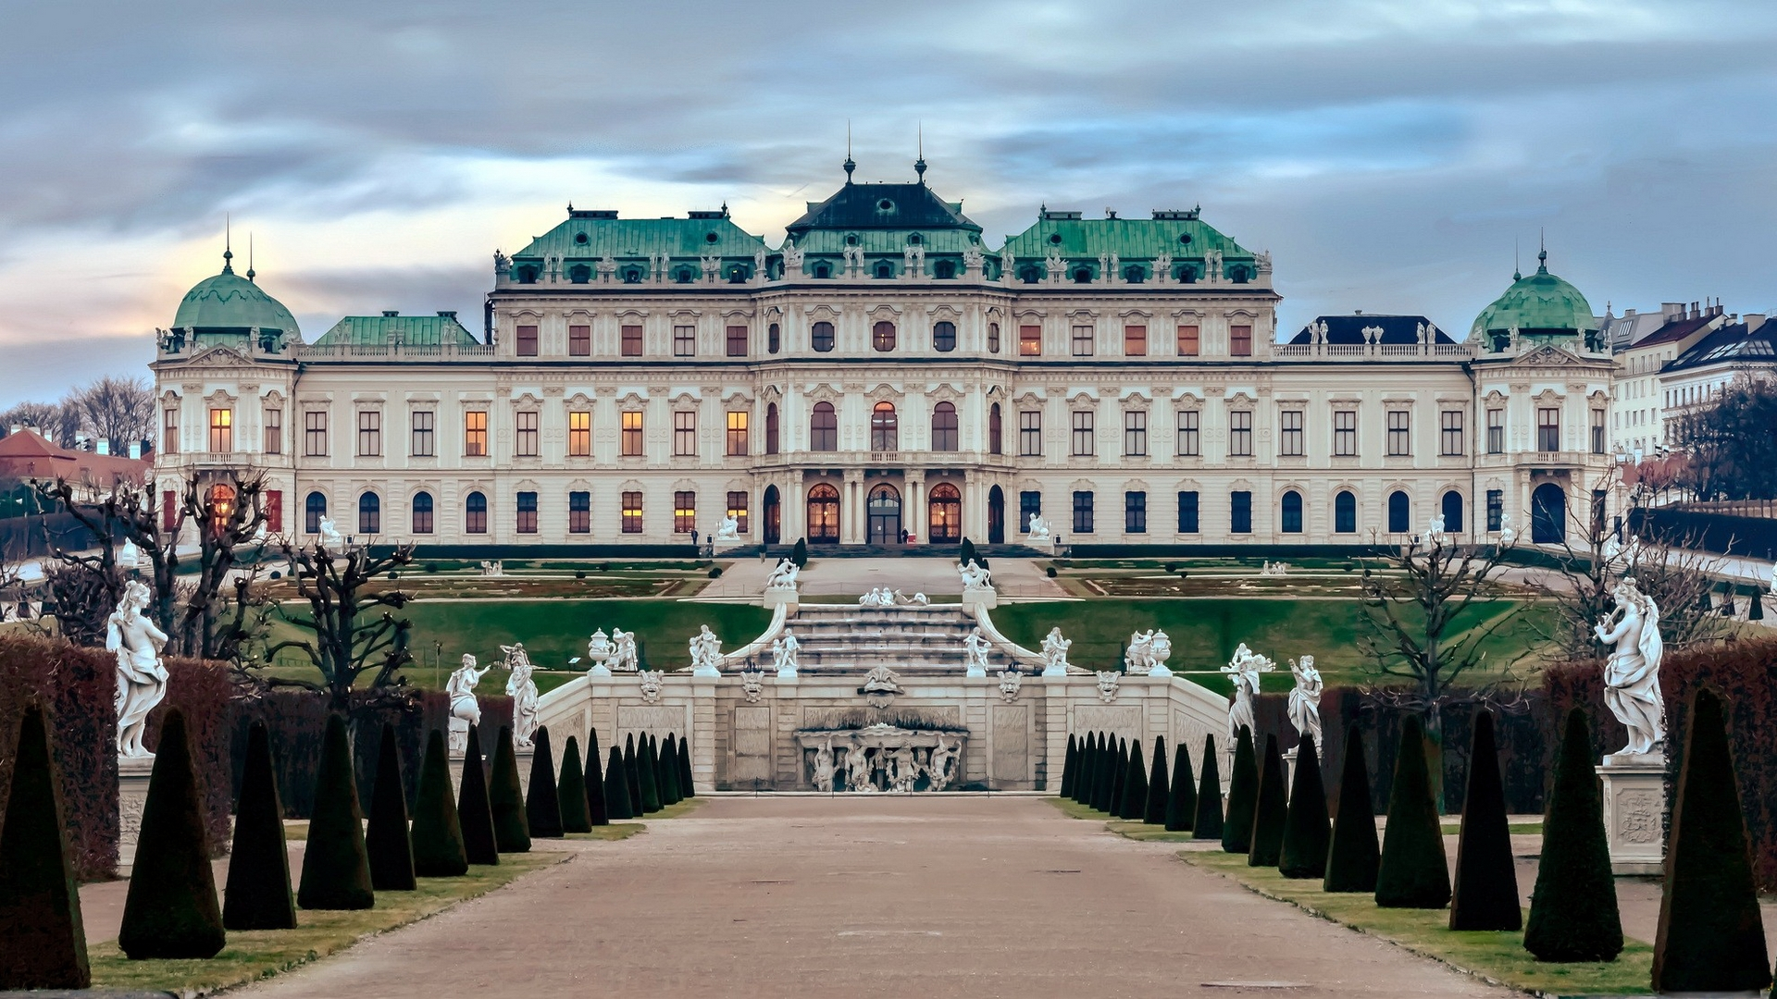
magnificent
Very great or beautiful
The king and queen lived in a magnificent palace.

Slide 4
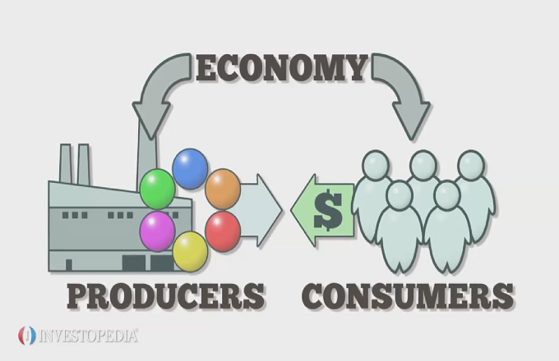
economy
Process of stuff being bought and sold
The economy depends on whether the merchants can purchase the supplies they need.

Slide 5
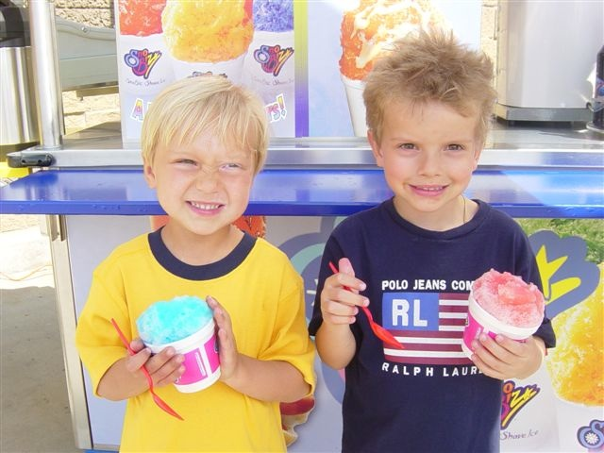
quench
To put something out
The shaved ice helped quench my thirst on the hot summer day.

Slide 6
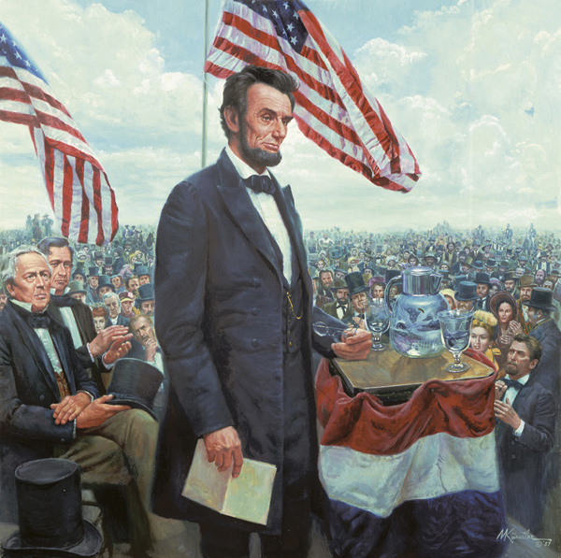
inspired
Encouraged to do something
Daniel was inspired by the president’s speech.

Slide 7
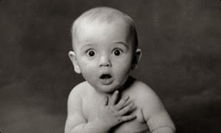
astonished
Great surprise
Jontel was astonished to see a rainbow after the storm.

Slide 8
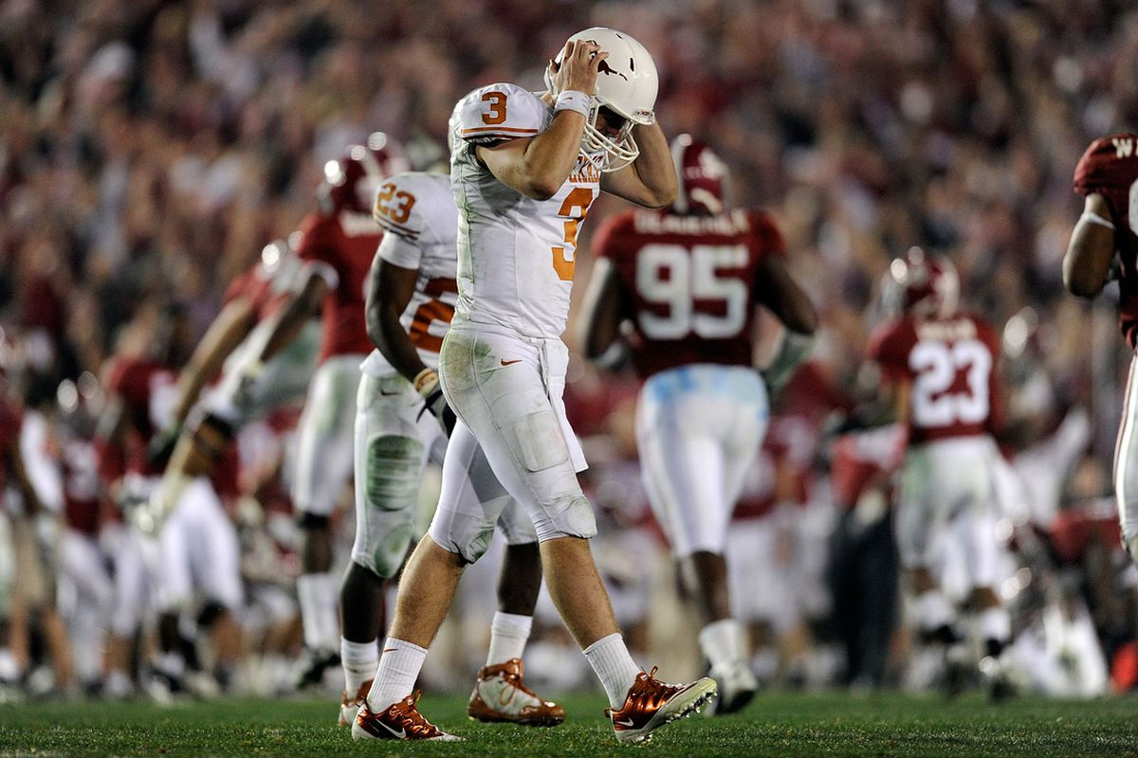
dejected
To feel sad because of loss
The football players felt dejected after they lost the playoff game.

Slide 9
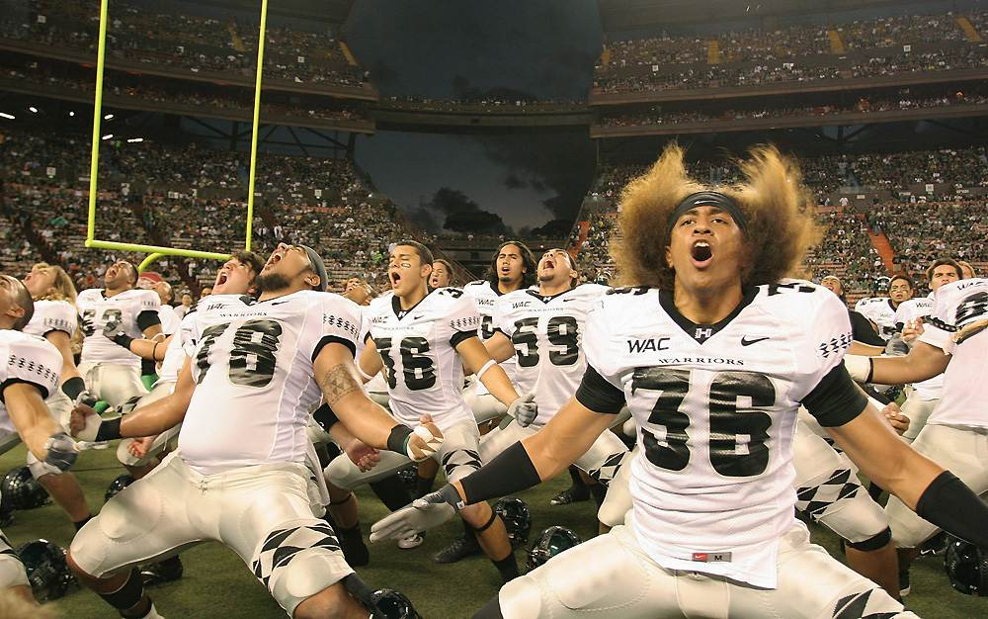
jubilant
To feel great joy
The football players felt jubilant after they won the playoff game.

