Slide 1
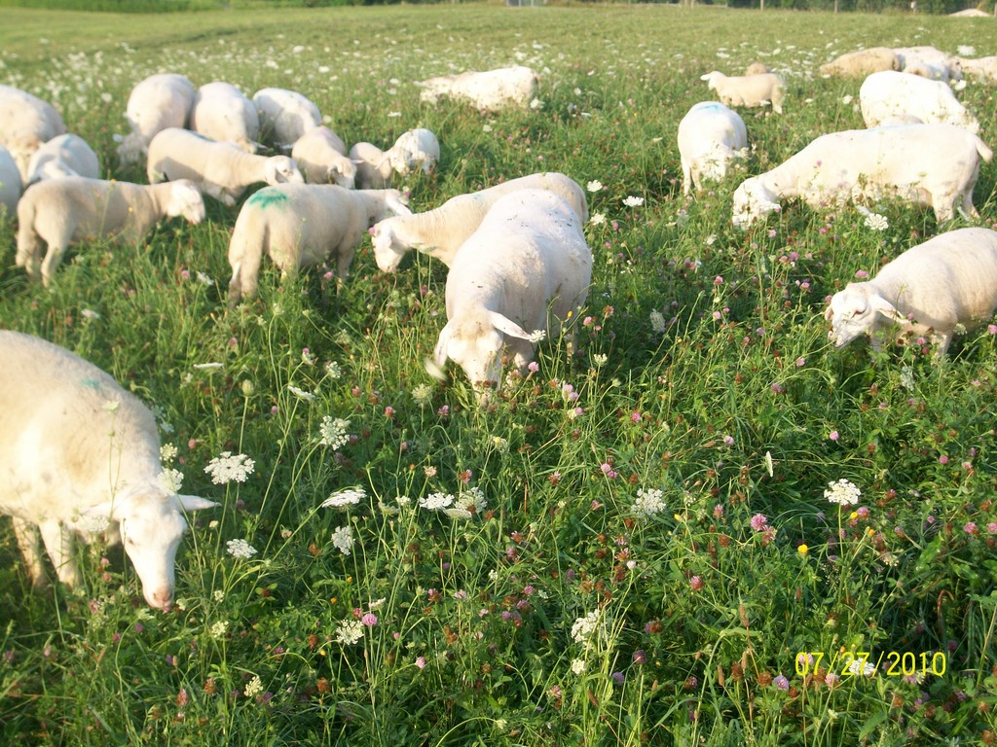
Thrive
WHEN A LIVING THING GROWS WELL
With such an abundance of green grass and clover to eat, the sheep will thrive.

Slide 2
tilt
slant or angle
Cookie Monster had to tilt the cookie jar to reach the crumbs at the bottom.

Slide 3
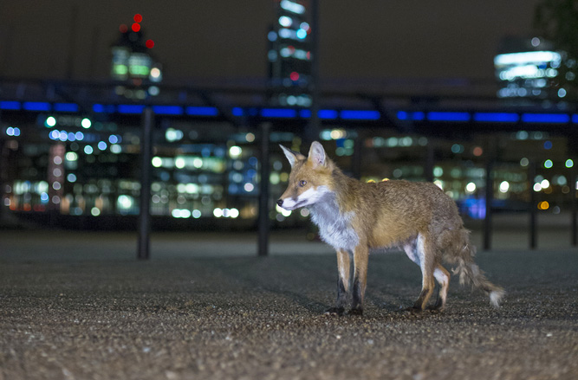
adapt
TO adjust or change
Many foxes that normally live in the wild have learned to adapt to a city environment.

Slide 4
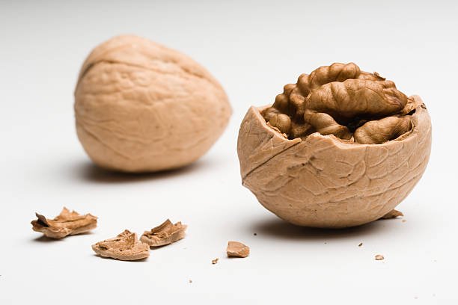
protective
Protect or shelter something
Many nuts have a protective outer layer called a shell.

Slide 5
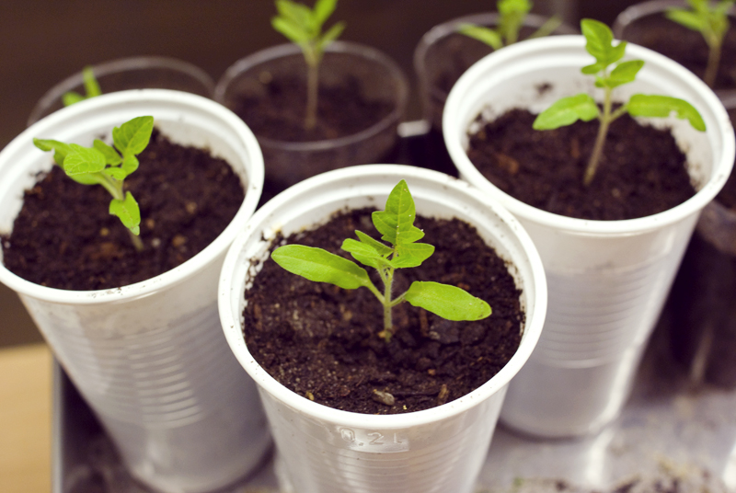
germination
A plant begins to grow/Sprout
The pea seeds planted in clear, plastic cups began the germination process near the warm, sunny window.

Slide 6
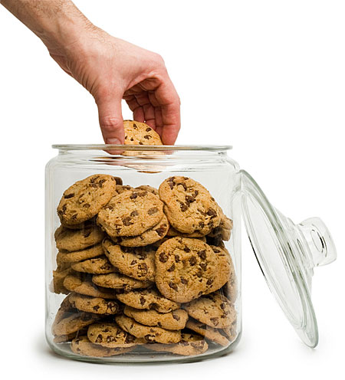
replenished
Replaced or refilled
The cookie jar was empty, so Mom replenished the contents.

Slide 7
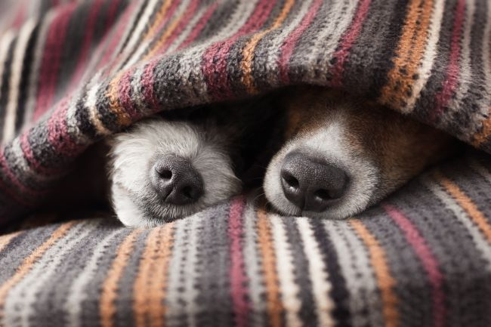
burrow
To make a hole in or under something
My dog loves to burrow under the blankets on my bed.

Slide 8
transparent
Clear; able to see through
Kayla planted her seeds in a large, transparent, plastic cup so she could watch the roots develop beneath the soil.

Slide 9
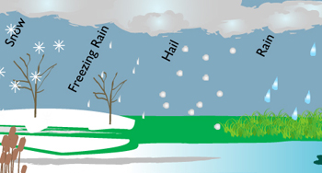
precipitation
WATER THAT FALLS FROM THE SKY
We are planning to have a picnic because there is no chance of precipitation today.

