Slide 1
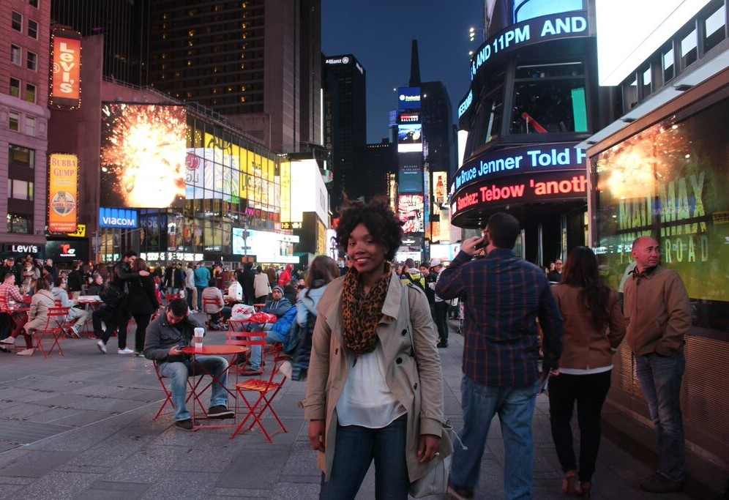
SIGHTS
Things or places seen
Juanita walked for hours and hours enjoying the sights and sounds of New York City.

Slide 2
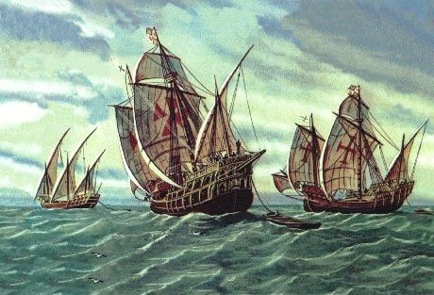
VOYAGE
A journey
Columbus’s first voyage to America was in 1492.

Slide 3
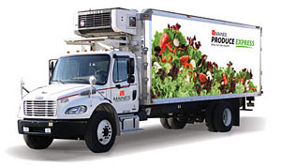
TRANSPORT
To carry from one place to another
Refrigerated trucks transport much of the produce that we buy in the grocery store.

Slide 4
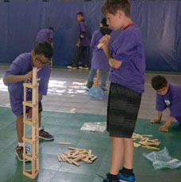
CREATE
To make something
My little brother and I are going to create a skyscraper using these blocks.

Slide 5
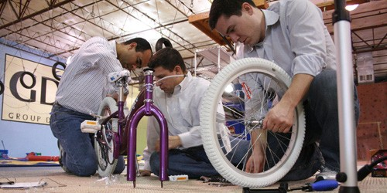
ENCOUNTER
Come across someone or something
Mustafa encountered many difficulties as he tried to build his daughter a bicycle from spare parts.

Slide 6
TERRITORY
Area of land that belongs to someone
Thomas Jefferson purchased the Louisiana Territory from France.

Slide 7
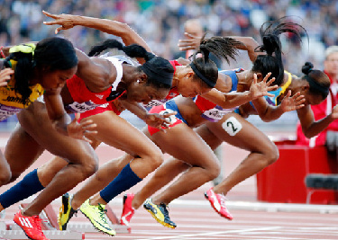
ENDURANCE
Ability to go for a long time without pain
Olympic athletes have great endurance and can exercise for a very long time.

Slide 8
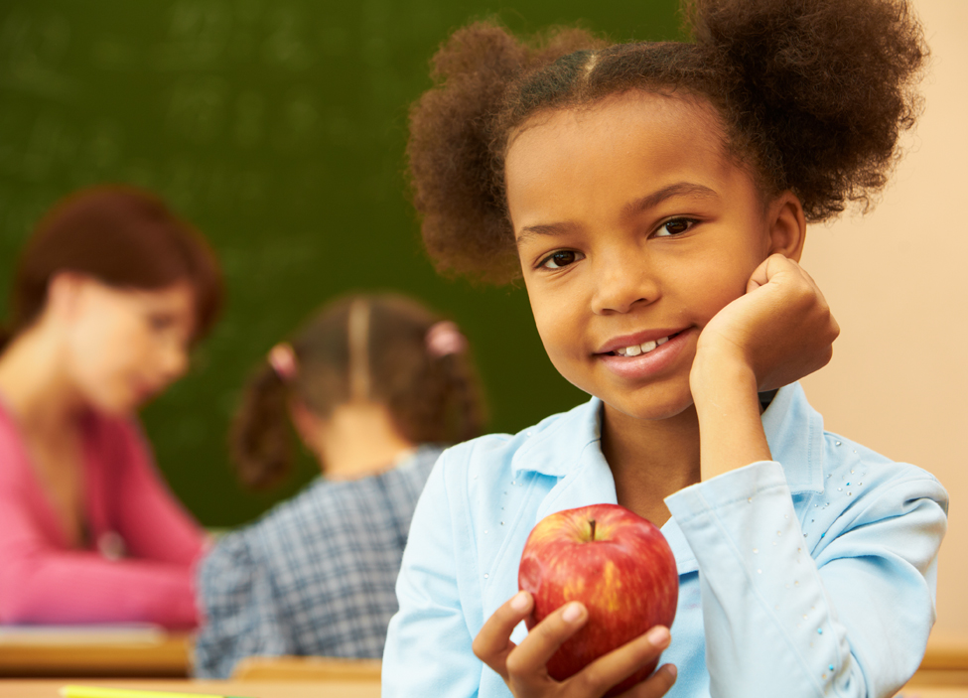
CONVENIENT
Helpful
It was convenient for Jane that her mom packed her an afternoon snack so she wouldn’t be hungry during school.

Slide 9
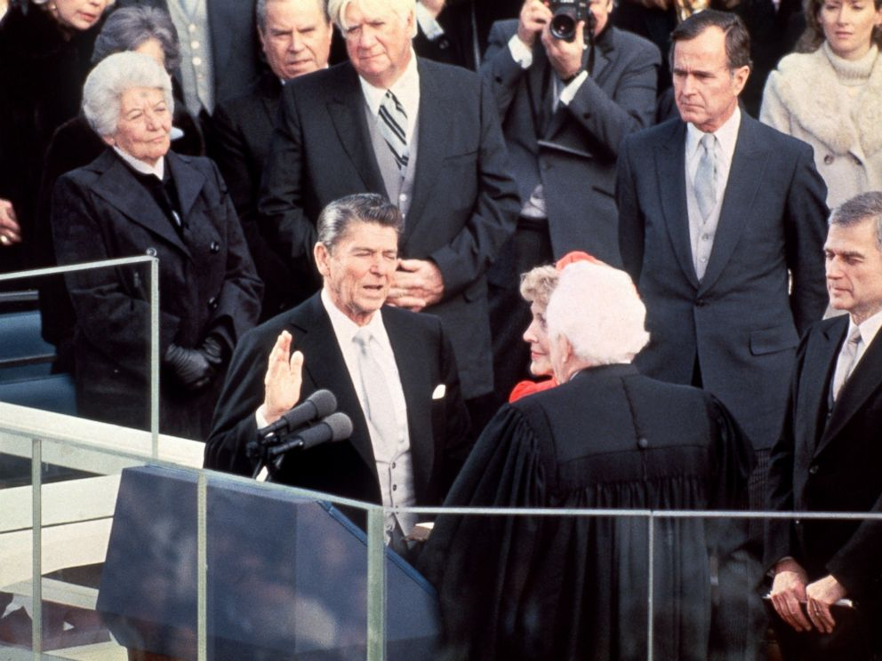
SOLEMNLY
Seriously
The new president solemnly swore to protect the country.

