Slide 1
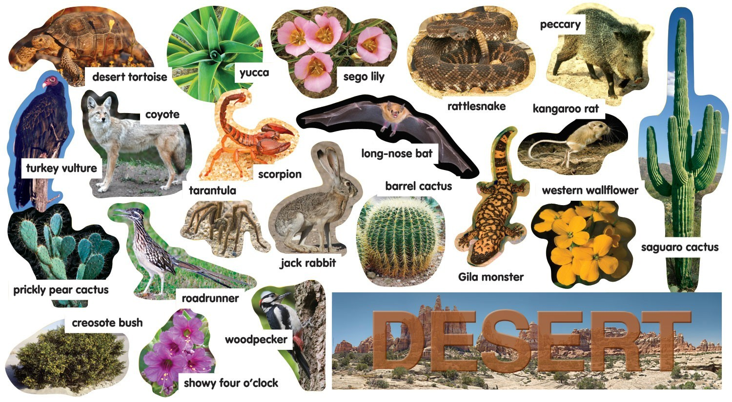
HABITATS
Natural homes of plants and animals
Desert habitats are home to plants and animals that can survive without regular rainfall.

Slide 2
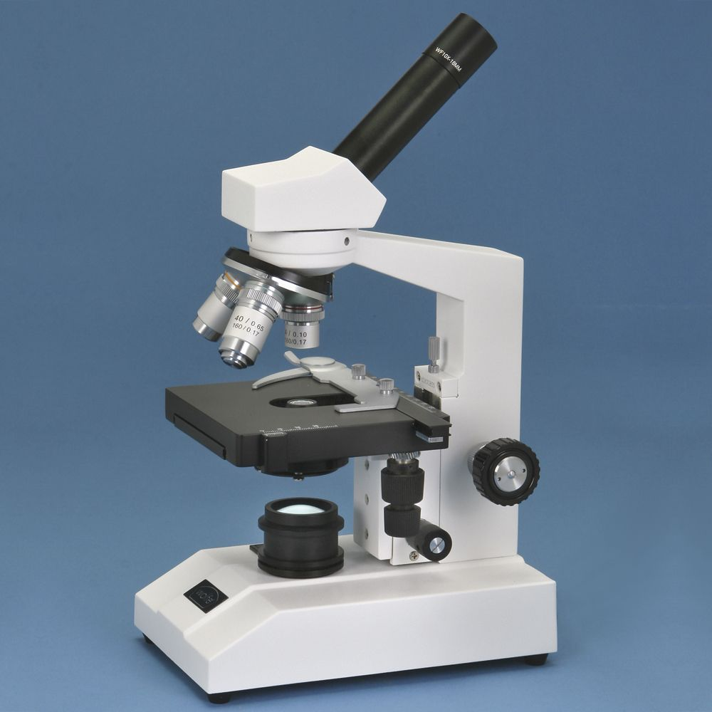
MICROSCOPIC
Too small to see without a microscope
Tiny microscopic bugs live in the pond behind my house, but they are too small for me to see with my eyes alone.

Slide 3
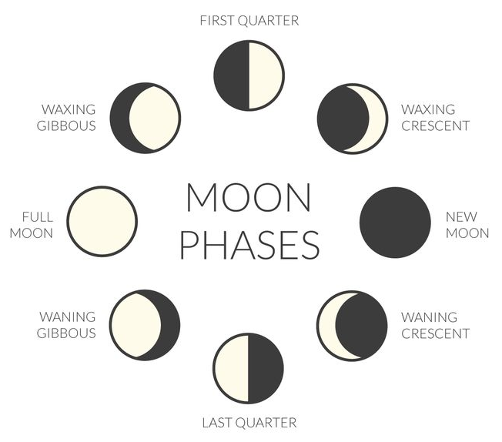
PROGRESSION
Actions or events that are repeated
The progression of the phases of the moon from new moon to full moon and back to new moon again follows a predictable pattern.

Slide 4
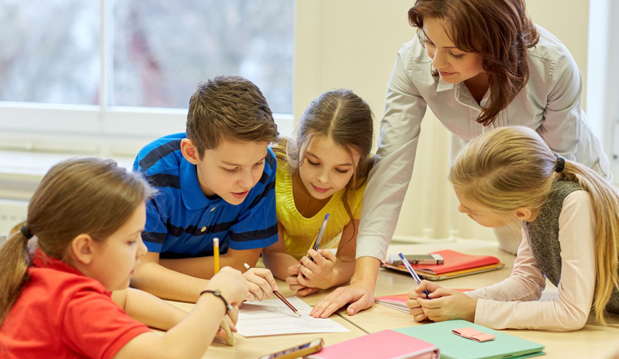
COOPERATE
To work together
Students cooperate with their teachers and their classmates so that everyone can learn.

Slide 5
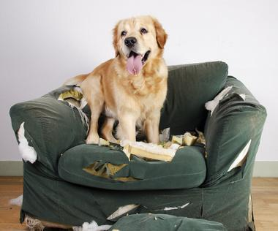
DESTRUCTIVE
Causing a lot of damage
The destructive dog chewed up the new sofa.

Slide 6
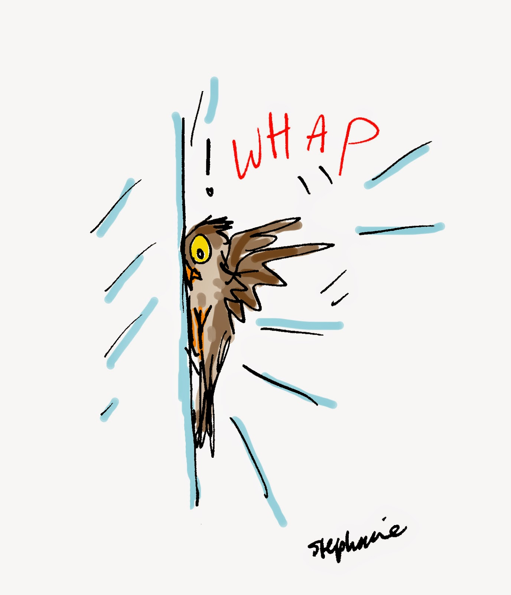
TRANSPARENT
A material you can see through
The bird bumped in to the transparent window, thinking that it was flying onto the porch.

Slide 7
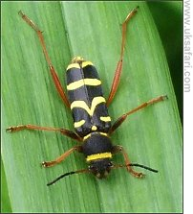
MIMICRY
To mimic or copy for protection
A wasp beetle’s mimicry, which makes it look like a stinging wasp, keeps its predators away.

Slide 8
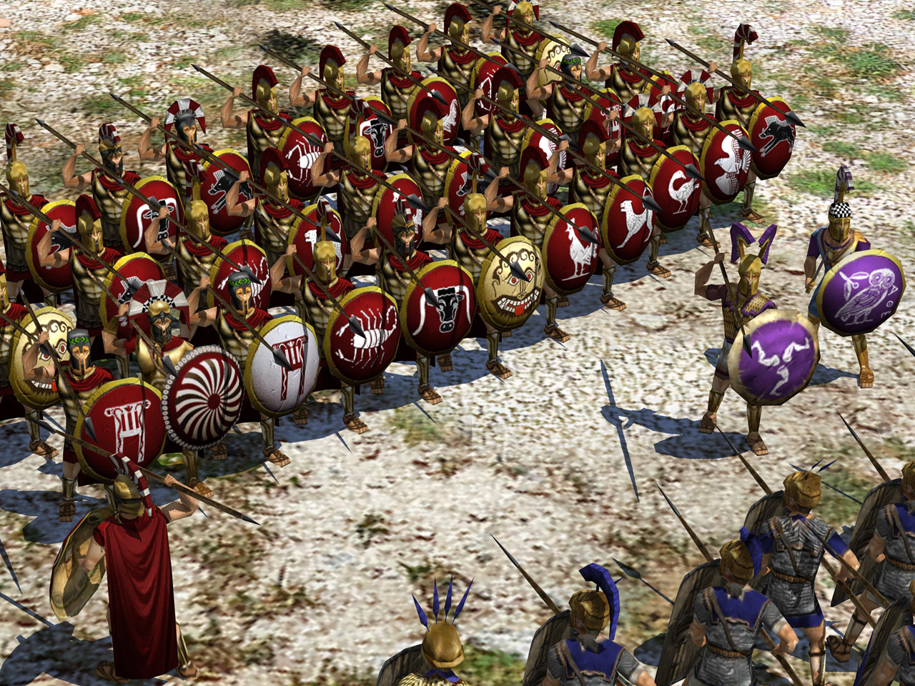
FOE
Enemy
The Athenians and Spartans of ancient Greece fought together against their foe, the Persian Empire.

