Slide 1
VALUE
Usefulness or Importance
Jorge’s father always stressed the value of getting a good education.

Slide 2
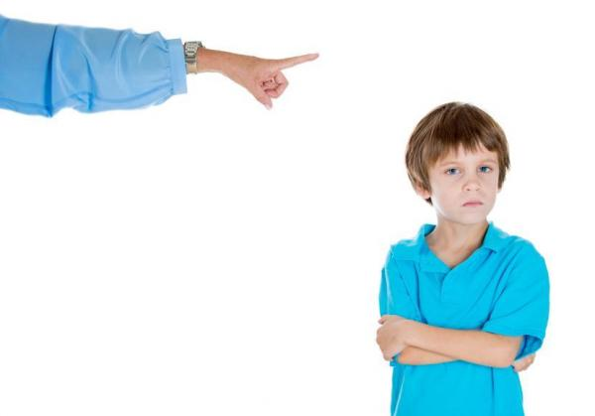
REBELLIOUS
Resisting, or fighting, being controlled by someone
Because John would not stay in his room, his parents told him he was being rebellious.

Slide 3
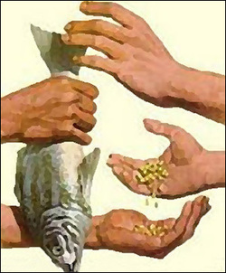
ECONOMY
Making and trading goods
Americans and people in other countries help make the U.S. economy stronger when they buy goods produced within the United States.

Slide 4
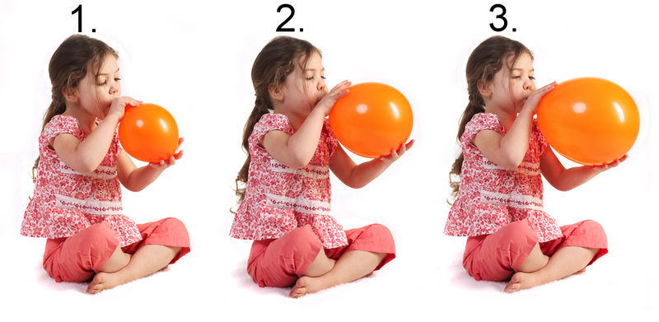
EXPAND
To spread out or to get bigger
The balloon began to expand as Mandy blew into it.

Slide 5
confederacy
Southern states’ government during the Civil War
The Confederacy was prepared to fight to keep the South’s way of life.

Slide 6
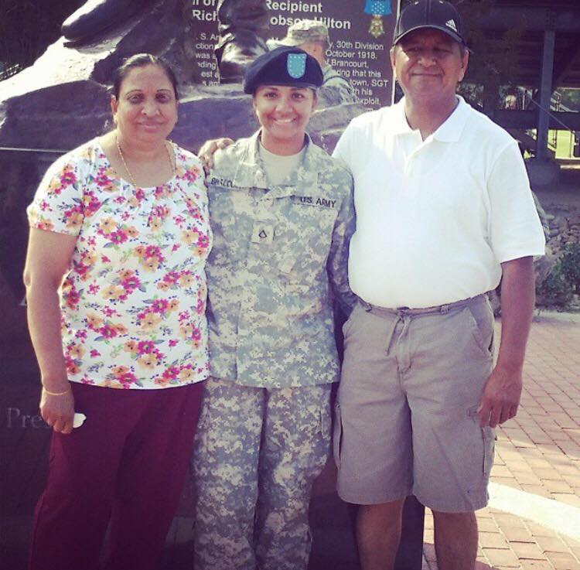
CIVILIANS
People that are not part of the military
Joshua’s mother is in the army, but his grandparents are civilians.

Slide 7
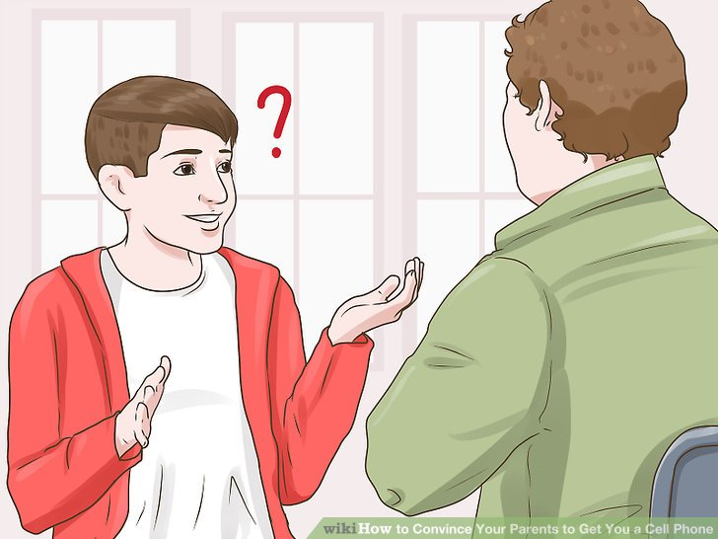
ADVISORS
People who give advice
I asked my parents to be my advisors when I couldn’t decide whether or not to play on the soccer team.

Slide 8
WOUNDED
The people who are injured
After the fire, the wounded were transported quickly to the hospital.

Slide 9
ABOLISHED
Ended
I had a nightmare that school had abolished summer vacation.

Slide 10
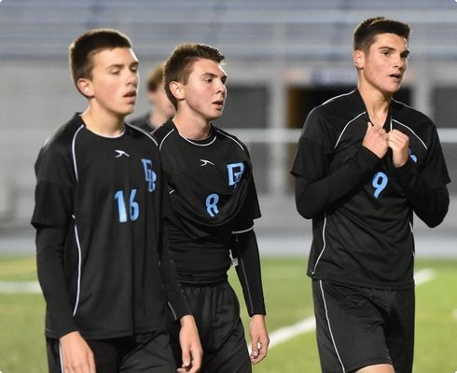
DEFEAT
Failure to win
Len’s soccer team experienced a disappointing defeat when the opposing team scored three goals and his team scored none.

Slide 11
UNITED
Joined together as one
In the United States, all of the states work together as one county.

